Slide 1
Project Based Learning Workshop
By:
Emad Dawwas
At Palestine Polytechnic University

Slide 2
introduction
What is team work and how it differs from individual work?

Slide 3
introduction
What criteria make a project a group-work and what makes it an individual?

Slide 4
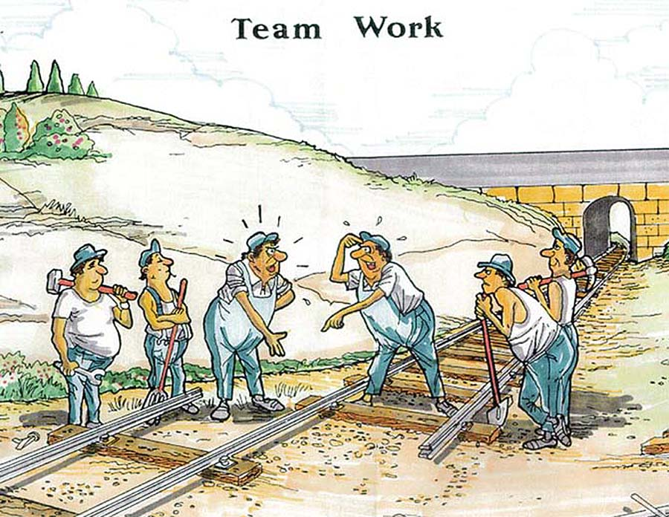
introduction
Do our students do team work?

Slide 5
introduction
What are the main advantages and disadvantages of group work?

Slide 6
What models are available for classes with projects?

Slide 7
What models are available for classes with projects?
Several approaches to involve project activities in theoretical classes
The challenge is always to manage these activities either:
Theory/practice ratio
Distribution
Four models are suggested about the ratio and distribution.

Slide 8
Model 1
Very common model
Theory is given more time (10 – 12 weeks)
Practice follows the theory
No enough time for follow up and scaffolding
Theory
Project

Slide 9
Model 2
No rush in the project activities but separated from the class materials
Common in classes with labs
Very difficult to manage
Theory
Theory
Project
Project

Slide 10
Model 3
Project takes its time
No rush in the project as both theory and practice go in parallel
Difficult to manage
More suitable for advanced classes (graduate classes)
Theory
Theory
Project
Theory
Project
Project

Slide 11
Model 4
Relatively equal time
Theory portion is descending while project activities are ascending
More suitable for introductory classes but still suitable for advanced ones
More suitable for CBL
Theory
Project

Slide 12
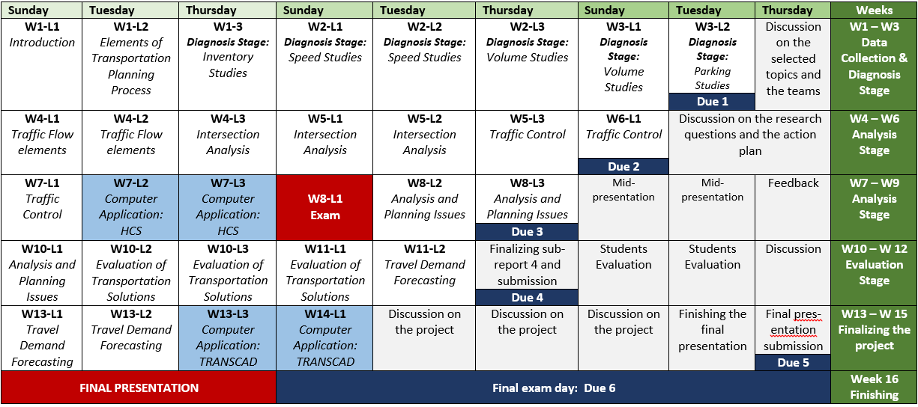
Urban Transportation Class

Slide 13
Project Selection
Group formation
Two approaches:
One project for all groups
One project for each group

Slide 14
Project Selection
What are the main criteria to consider when selecting a class project?
Time
Student quality
Your confidence:
how many time have you taught the class
Is it from your core field

Slide 15
Project Selection
What are the main criteria to consider when selecting a practice-theory model?
Theory
Theory
Theory
Project
Theory
Project
Project
Project

Slide 16
Planning
What are the main components of the action plan?
How to distribute the work among the teams
What pitfalls should be considered?

Slide 17
Planning Example
Course Plan
Main Stage | Week No. | Session | Topic
Introduction | Week 1 | Class | - Introduction to GIS and Community Based Learning (CBL) - Course outline
 |  | Lab | Exploring ArcMap 10 and ArcCatalog 10
 |  | Field work | ---
 | Week 2 | Class | Planning a GIS project: Stage 1) Data collection and assembling Stage 2) Data preparation Stage 3) Data analysis Stage 4) Data presentation
 |  | Lab | - Geo-referencing and Projecting Spatial Data - Introducing Field Survey Form
 |  | Field work | - Forming project teams - Training on data collection

Slide 18
Planning Example
Course Plan
Stage 1: Data Collection and Assembling | Week 3 | Class | Collapse Mechanisms due to Earthquake in Urban Buildings—Part 1 (Guest speaker from Urban Planning and Disaster Risk Reduction Center)
 |  | Lab | Geo-referencing Nablus map Exercise 1: Building a Geodatabase using the data sample collected in Week 2
 |  | Field work | - Dividing the study area among different teams - Data collection
 | Week4 | Class | Spatial Database Structures and Data Models
 |  | Lab | Introducing basic vector and raster tools Exercise 2: Applying concepts of vector and raster analysis on the field data sets
 |  | Field work | Data collection

Slide 19
Planning Example
Course Plan
Stage 2: Data Preparation | Week 5 | Class | Collapse Mechanisms due to Earthquake in Urban Buildings—Part 2 (Guest speaker from Urban Planning and Disaster Risk Reduction Center)
 |  | Lab | Investigating Data Management and Data Analysis toolboxes Exercise 3: Applying Data Management and Data Analysis tools on the field data sets
 |  | Field work | Data collection
 | Week 6 | Class | Topology and ArcGIS 10 Network Analyst Extension
 |  | Lab | Working with Network Analyst Exercise 4: Applying Network Analyst on Nablus road network
 |  | Field work | Data collection
 | Week 7 | Class | The Importance of an Earthquake Evacuation Plan for the City of Nablus (Guest speaker from Engineering Department in the municipality of Nablus)
 |  | Lab | Midterm Exam
 |  | Field work | Data collection

Slide 20
Planning Example
Course Plan
Stage 3: Data Analysis | Week 8 | Class | Collapse Mechanisms due to Earthquake in Urban Buildings—Part 3 (Guest speaker from Urban Planning and Disaster Risk Reduction Center)
 |  | Lab | Data analysis
 |  | Field work | Data collection
 | Week 9 | Class | Case Study 1: Evacuation Planning in Earthquake Disasters, Using RS & GIS
 |  | Lab | Data Analysis
 |  | Field work | Data collection
 | Week 10 | Class | Case Study 2: An Interactive Mapping Application for Rapid Evacuation Planning Using GIS
 |  | Lab | Midpoint Presentation
 |  | Field work | Filling gaps in collected data
 | Week 11 | Class | Guidelines for organizing final analysis results
 |  | Lab | Final results
 |  | Field work | ---

Slide 21
Planning Example
Course Plan
Stage 4: Data Presentation | Week 12 | Class | Case Study 3: Developing a Transportation Plan for Evacuation of Builtup Areas in Case of Earthquake Collapse
 |  | Lab | Generating final maps
 |  | Field work | ---
 | Week 13 | Class | Guidelines for writing the final report
 |  | Lab | Wrapping up: bringing all project’s parts together
 |  | Field work | ---
 | Week 14 | Class | Guidelines for preparing the final presentations
 |  | Lab | Working on the final presentation
 |  | Field work | ---
 | Week 15 | Class | Final report submission and final presentation

Slide 22
Managing and Evaluating
How to plan and manage follow up meetings?
What main criteria usually instructors consider when evaluating team projects?
How to evaluate

Slide 23
Challenges

