Slide 1
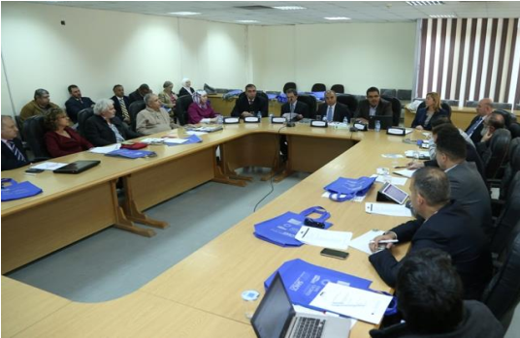
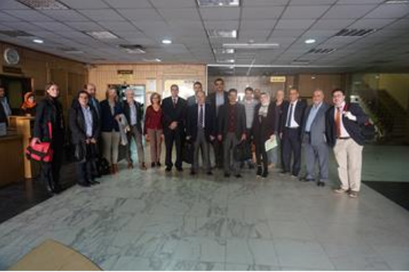
Modernization of tEaching meThodologies in higher educatiOn: EU experience for jorDan and paleStine “METHODS”
Prepared by:
Dr. Wasel Ghanem

Slide 2
Methods consortium
Regional and Local Partners:
Jordan:
University of Jordan
Jordan university of Science and Technology
Al-Zaytoona University
Hashmate University
Palestine :
Birzeit University
An-Najah University
Palestine Polytechnic University
Bethlehem University
EU Partners:
University of Wolverhampt –UK
HOCHSCHULE FUR TECHNIK WIRTSCHAFT UND KULTUR LEIPZIG-Germany
UNIVERSIDAD DE LA IGLESIA DE DEUSTO- Spain
UNIVERSITAT DE GIRONA-Spain
World University Service of the Mediterranean-Spain
AALBORG UNIVERSITET-Denmark
Plovdiv University "Paisii Hilendarski“-Bulgaria

Slide 3
Main objective

Slide 4
Specific objectives

Slide 5
Outputs and outcomes

Slide 6
Major activities accomplished
Implementation of Quality Work Package
The quality plan was prepared aiming to process the quality assurance activities and impact evaluation of the project. It describes the goals, the impact criteria, the methodology and the outcomes of our quality assurance in the project, including a verification of targets and success indicators.
Implementation of Base line Study Work Package It aims to:
Verify the facilities of partners to develop the existing resources in partner universities
Develop and update the strategies used to ensure the sustainability to utilize ICT in education, taking into consideration the past experiences and lessons learnt of both EU and PC universities.
Two questionnaires were designed and circulated to target the academic staff and the students at Jordanian and Palestinian partner universities.

Slide 7
Major planned activities
Implementation of Networking Work package
Building a wide network for METHODS project; by inviting the educational public administrations, ministries, companies, NGOs and employment agencies in modernizing higher educational methodologies to join METHODS network in all partners’ countries. This network will enhance the cooperation and the exchange of good practice between the members through the METHODS portal; furthermore it will facilitate the participation in common actions between the members of the METHODS Network, such as: seminars, submission of proposals and development of projects.
Implementation of Capacity building and development Work Package
Developing a first prototypes of training materials and benchmarks will be one of the major activities in the next six months; this will help to make sense of the theory of utilizing best practices of ICT in education and enable real world application.

Slide 8
Thank You

