Slide 1
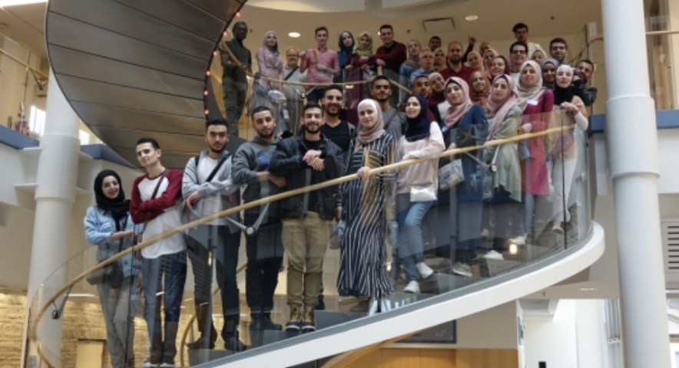
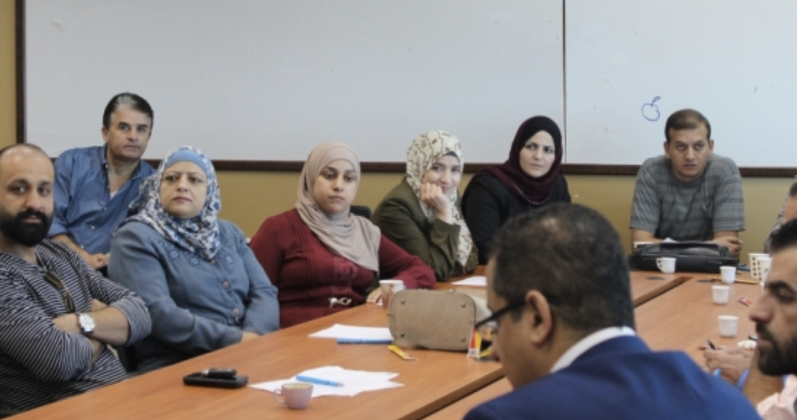
Palestine Polytechnic University
Developing Effective Presentation Skills

Slide 2
Speaking in front of others
Developing an interesting and engaging presentation
Presenting findings via effective PPT presentations
Working on a team presentation
Overcoming your fears!

Slide 3
Have you ever given a presentation or talked in front of a group of people?
Were these “good” experiences or “not so good”? Why?
Have you ever seen someone speak in public?
Is getting up to talk in front of others something you would like to do, or not? Why?
Of what value is it to be able to give effective presentations?

Slide 4
2 main reasons for making in-class presentations
Sharing what you have learned with your classmates for their educational benefit
Equipping you to make strong and effective presentations to others in the “real world”
Presentations are a way to build and improve your skills in a risk-free environment

Slide 5
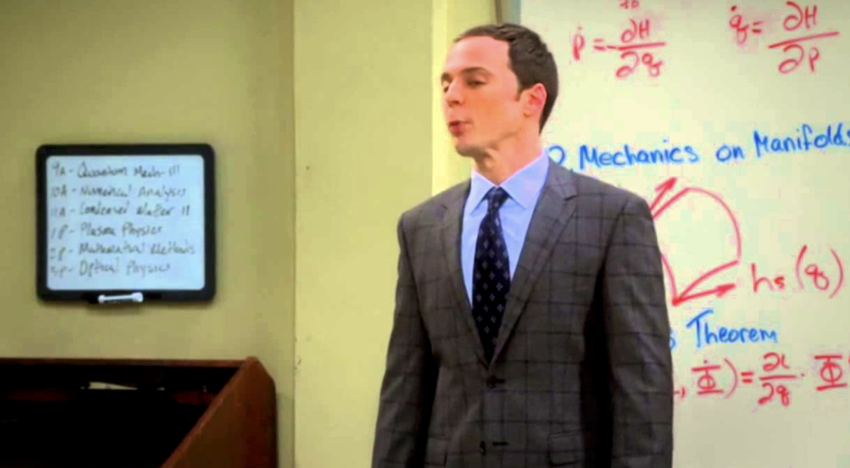
Presentations university students are most likely to make
1. Informative/Instructional
Factual and thorough
Report/explain findings
Give specific directions or orders
Designed to teach something completely new
Often includes theory and application
Organized from most to least important topics
Effective for breaking down a large amount of information into smaller pieces
Ex. University lectures and classes, research results, training demonstrations
Notes:
https://www.slideshare.net/jimaspinall3/types-of-presentations

Slide 6
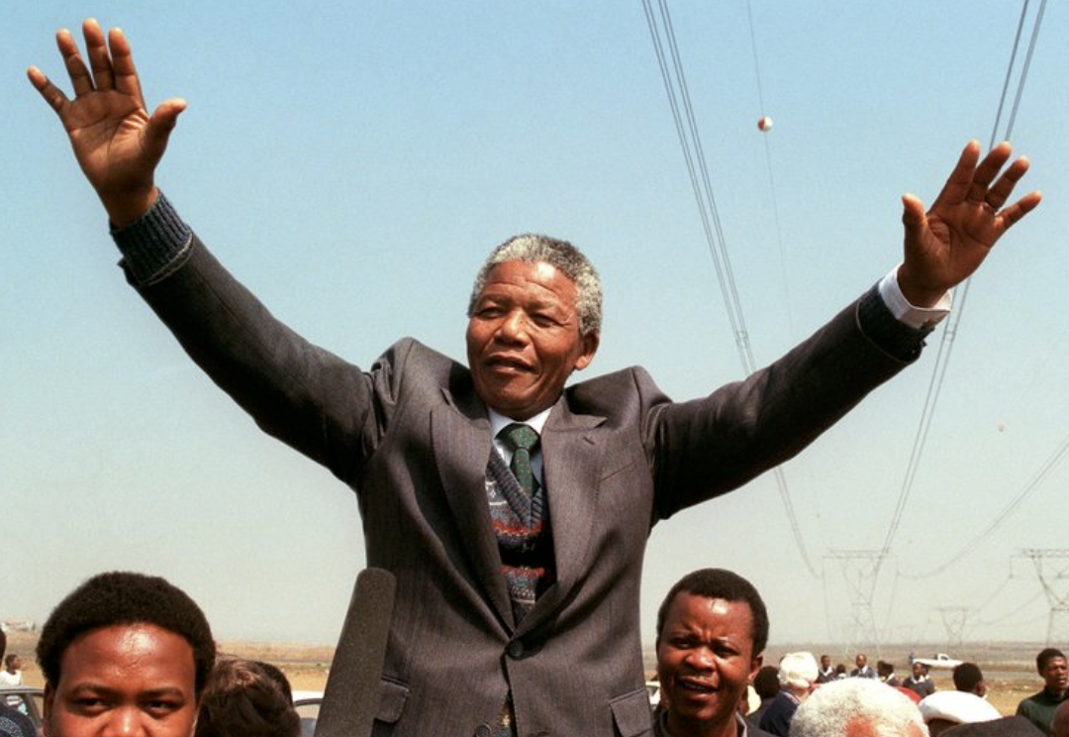
Presentations university students are most likely to make
2. Persuasion
Designed to make audience consider a topic/idea
Intended to rouse interest and emotions of audience
Uses powerful language, stories and real life examples to generate interest
Convince others -- Make listeners accept/agree presenter’s position
Uses supporting facts and advantages to reinforce credibility
Presents problem, presenter’s solutions and reasons behind it
Ex. Generating support for social issues
Notes:
https://www.slideshare.net/jimaspinall3/types-of-presentations

Slide 7
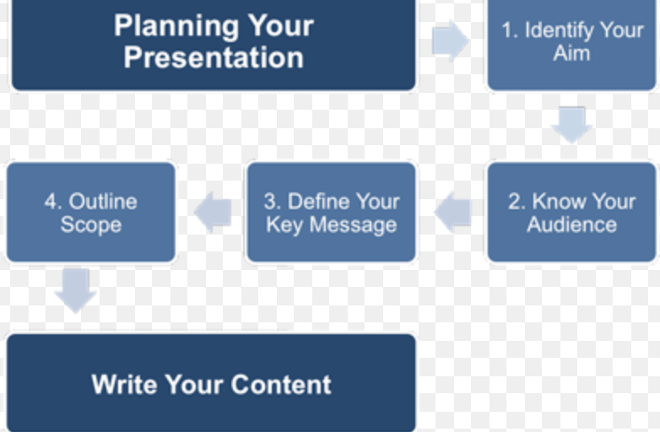

Slide 8
Tell them what you are going to tell them
TELL THEM
Tell them what you told them

Slide 9
What do you want the audience to know, do, understand, agree to, etc. at the end of the presentation?
Notes:
https://www.thinkoutsidetheslide.com/lesson-1-creating-a-presentation-outline/

Slide 10
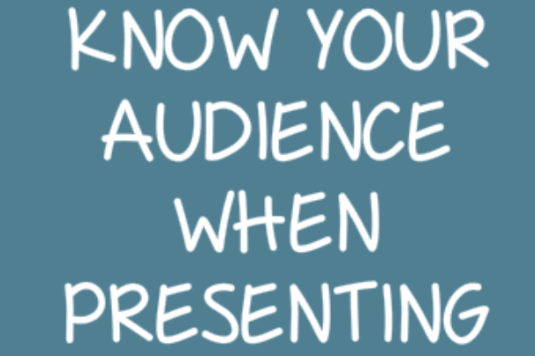
What do they already know about your topic?
What are they expecting to hear?
How can you capture their interest?
What concerns or objections might they have?
How much do they know you/trust you?
How large is the audience?
Notes:
https://www.thinkoutsidetheslide.com/lesson-1-creating-a-presentation-outline/

Slide 11
Main topics you want to cover
Points to make for each main topic
Supporting information to back up each topic
Notes:
https://www.thinkoutsidetheslide.com/lesson-1-creating-a-presentation-outline/

Slide 12
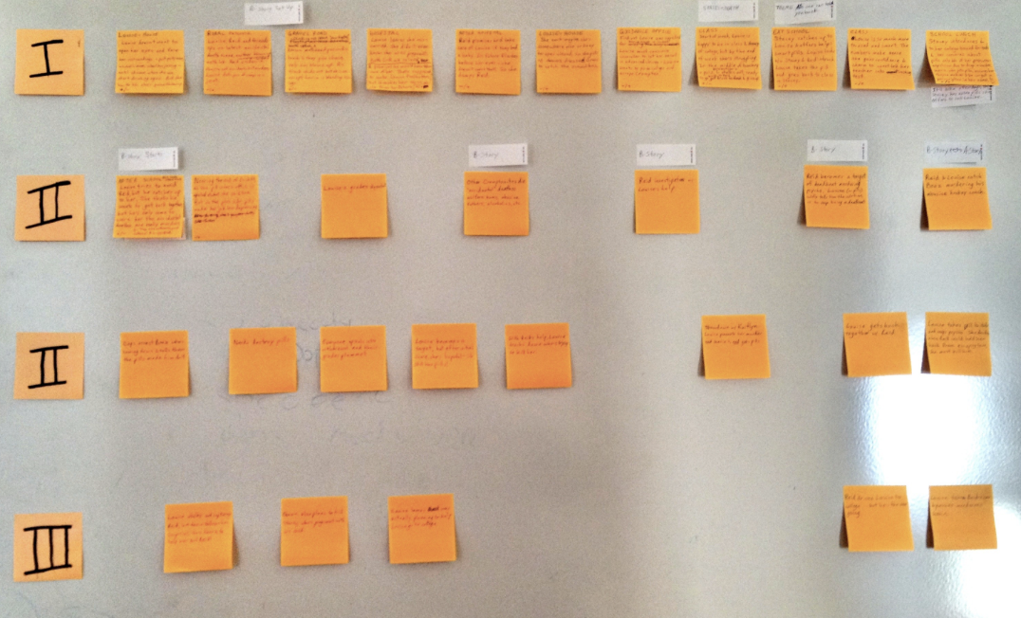

Slide 13
Notes:
https://24slides.com/presentbetter/12-ideas-interactive-presentation/

Slide 14
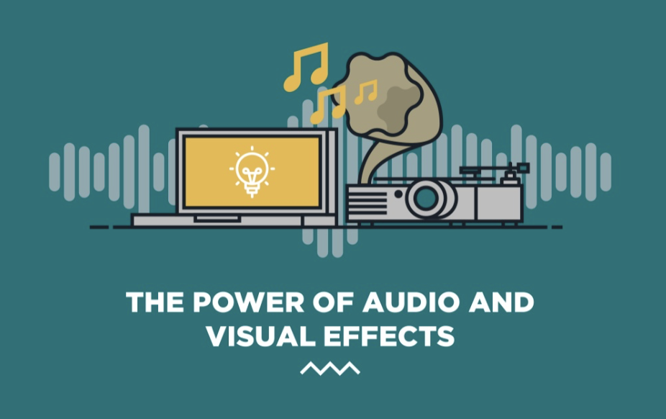
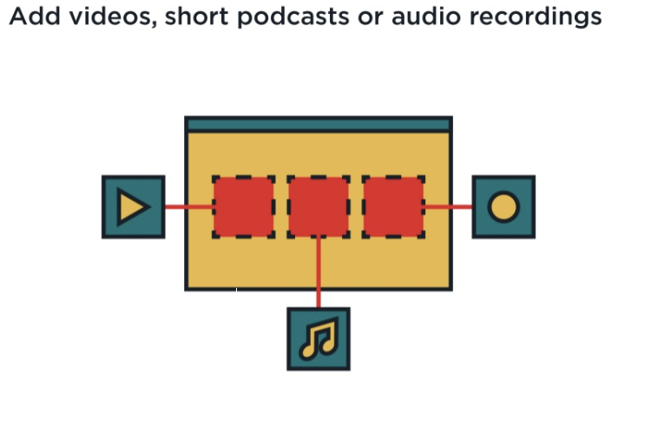
Include videos to illustrate points & use as discussion starters with your audience
Notes:
https://24slides.com/presentbetter/12-ideas-interactive-presentation/

Slide 15
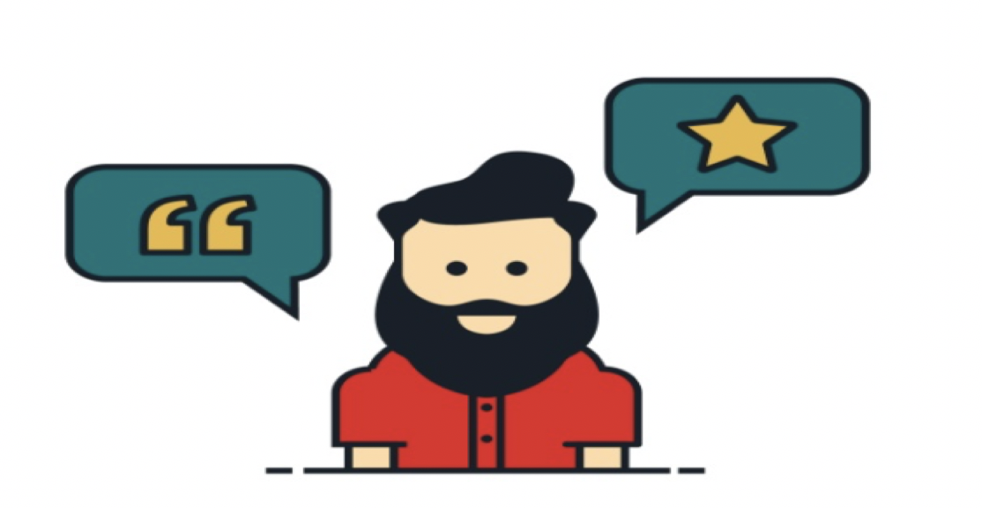
Share a story
Develop your story telling skills to deliver your message
Real life stories and examples make your presentation more relatable
Notes:
https://24slides.com/presentbetter/12-ideas-interactive-presentation/

Slide 16
Ask the audience questions
Especially effective at the beginning to signal desire for interaction
Take a poll
Get people’s opinions
Include videos to use as discussion points with your audience
Incorporate a role play and ask for volunteers from the audience
Ask audience to guess certain facts or data
Give a “quiz”
Notes:
https://24slides.com/presentbetter/12-ideas-interactive-presentation/
https://blog.prezi.com/8-ways-to-make-your-presentation-more-interactive/

Slide 17
Answering Questions from the Audience
Really LISTEN to the question being asked
Make sure you understand the question, get clarification if needed
Repeat the question so others in the audience have heard it
Allow yourself a pause to think for a moment
Respond to the question briefly and clearly
Make sure you can speak to any questions directly related on your ppt slides
Try to anticipate questions the audience may have and know how to answer them in advance

Slide 18
Be honest if you don’t know the answer
“I had not thought of that…”
“I really don’t know, but I will get back with you…”
Involve the audience to get their insights
“This is a really interesting question, does anyone know the answer?”
”What are your thoughts?”
Be prepared, but do not feel as if you have to know everything. If you don’t know it is better to be honest than to try to pretend.

Slide 19
What if the question asked will be answered later in the presentation?
“That’s a really good question. We will be getting to that issue later in the presentation. Do you mind if we get back to it then?”

Slide 20
A few more delivery tips
Dress for the occasion – when in doubt dress “up”
Remember to introduce yourself
Tell the audience up front what you will be talking about
Be enthusiastic – show the audience that you care about them and your topic
If you have notes, do not hold them
Place them so you can see them
Glance at them, don’t read them
Best if you do not use notes
Face and talk to the audience not the projected slides
Remember that the slides are the backdrop only
Project your voice
Maintain frequent eye contact with audience
Make sure your nonverbals match what you are saying and are not distracting
Be conscious of your timing
If you are using ppt slides, have a backup to access if needed
Make sure the technology, including audio/speakers/internet works
Notes:
https://www.siue.edu/lss/speechcenter/group_presentations.shtml

Slide 21
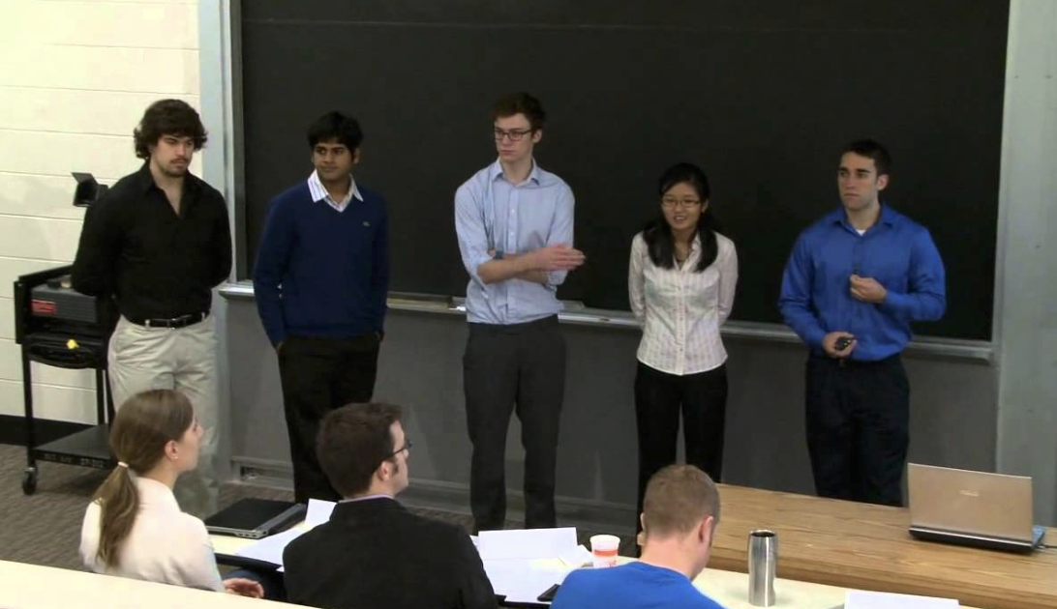
Tips for team presentations -- Create ONE presentation
Work together to:
have a unified presentation …One introduction, body, and conclusion
build a strong supporting case
One person compiles the slides from everyone into one slideshow
Use only one template/slide style
Everyone contributes (research, content, proofing, presenting, etc.)
Keep a group mindset - Say “we found ...” not “I found ...”
Notes:
https://www.siue.edu/lss/speechcenter/group_presentations.shtml

Slide 24
SPEAKING IN FRONT OF OTHERS
*
* Well, A LOT of people do!

Slide 25
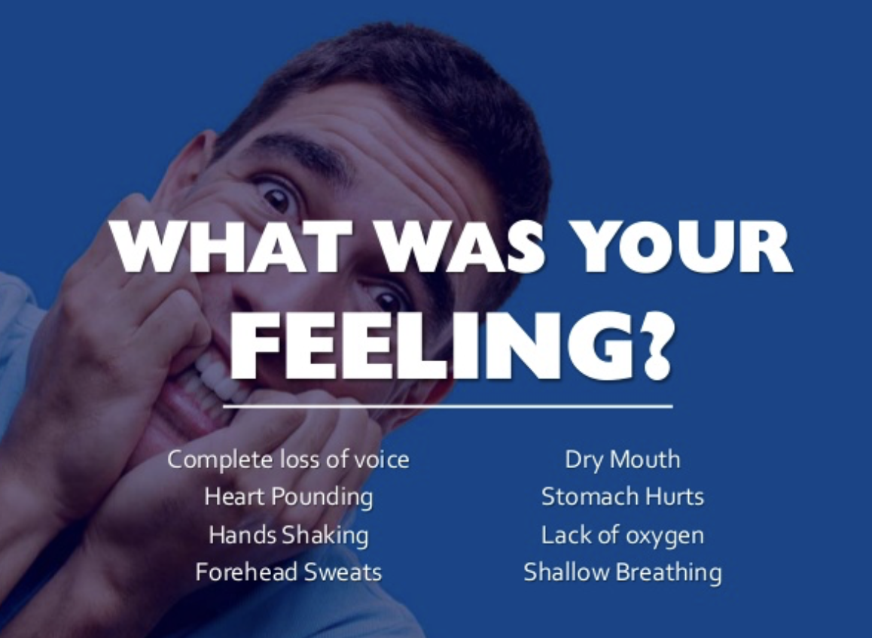
Common reactions
Notes:
https://www.slideshare.net/alaamoustafa/glossophobia-fear-of-public-speaking/4-alaamoustafaWHAT_WAS_YOURFEELINGComplete_loss_of

Slide 26
There is no magic formula for success

Slide 27
Everyone can develop…

Slide 28
Notes:
https://www.slideshare.net/alaamoustafa/glossophobia-fear-of-public-speaking/4-alaamoustafaWHAT_WAS_YOURFEELINGComplete_loss_of

Slide 29
Notes:
https://www.slideshare.net/alaamoustafa/glossophobia-fear-of-public-speaking/4-alaamoustafaWHAT_WAS_YOURFEELINGComplete_loss_of

Slide 30
KNOW YOUR SUBJECT

Slide 31
KNOW

Slide 32
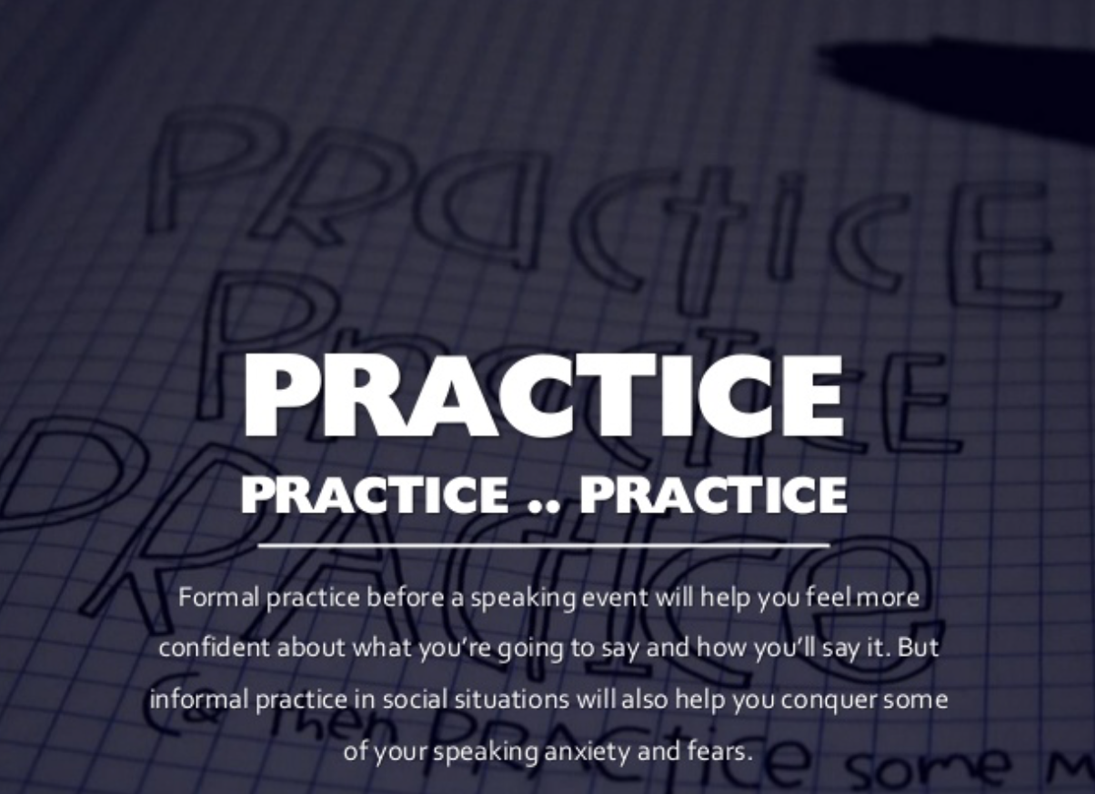
Notes:
https://www.slideshare.net/alaamoustafa/glossophobia-fear-of-public-speaking/4-alaamoustafaWHAT_WAS_YOURFEELINGComplete_loss_of

Slide 33
Notes:
https://www.slideshare.net/alaamoustafa/glossophobia-fear-of-public-speaking/4-alaamoustafaWHAT_WAS_YOURFEELINGComplete_loss_of

Slide 34
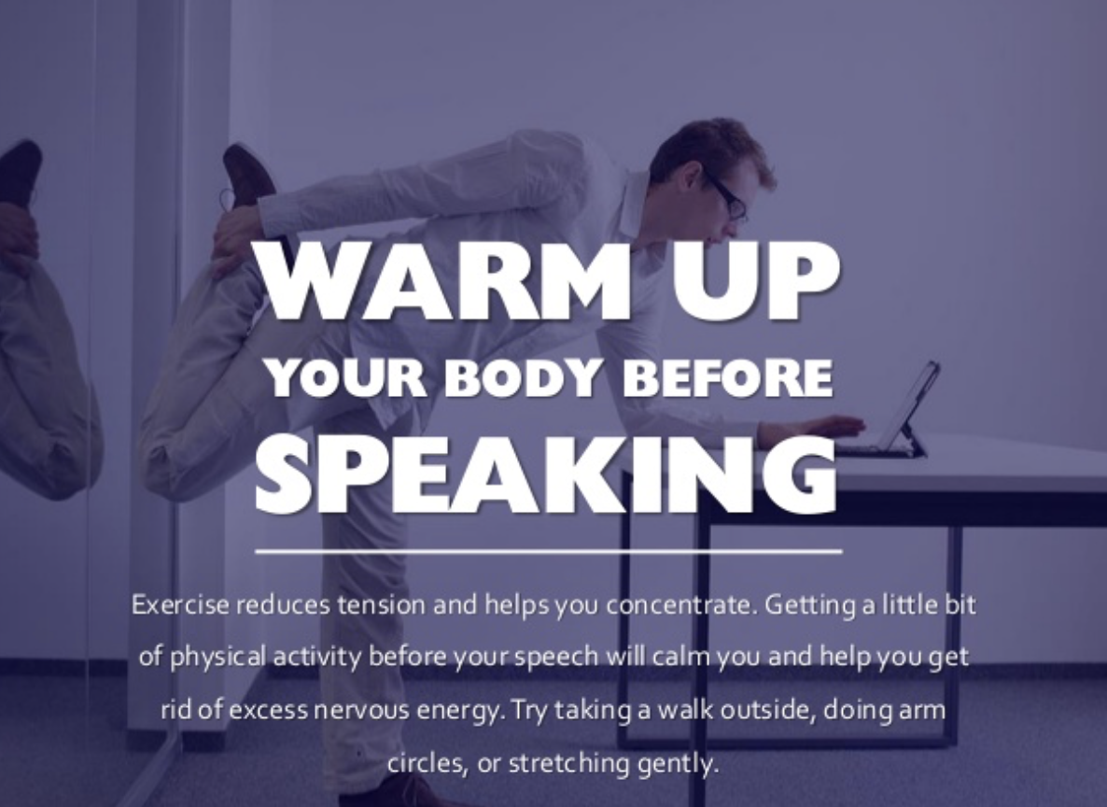
Notes:
https://www.slideshare.net/alaamoustafa/glossophobia-fear-of-public-speaking/4-alaamoustafaWHAT_WAS_YOURFEELINGComplete_loss_of

Slide 35
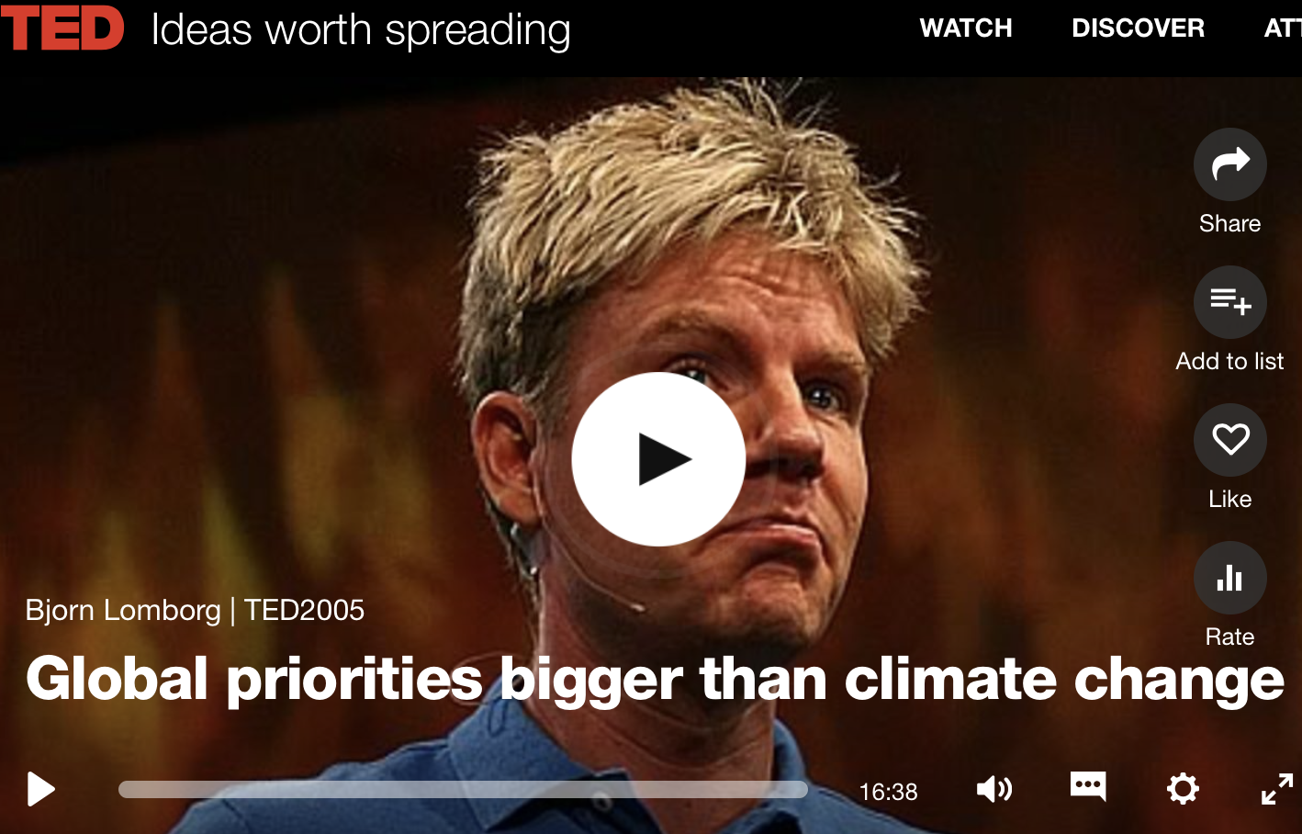
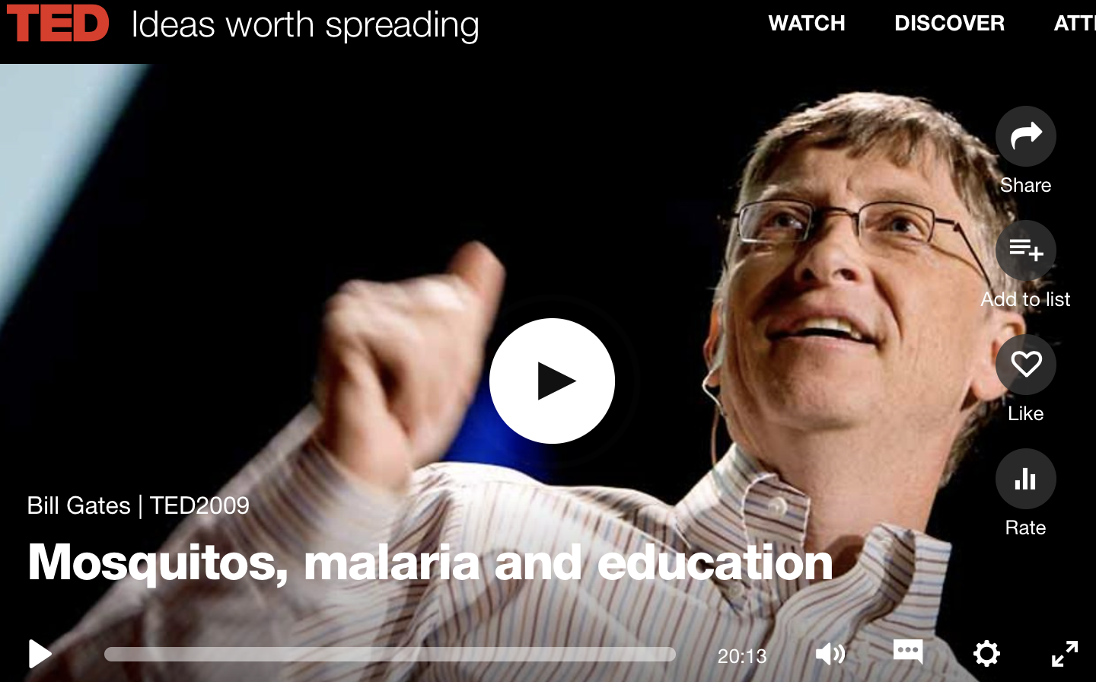
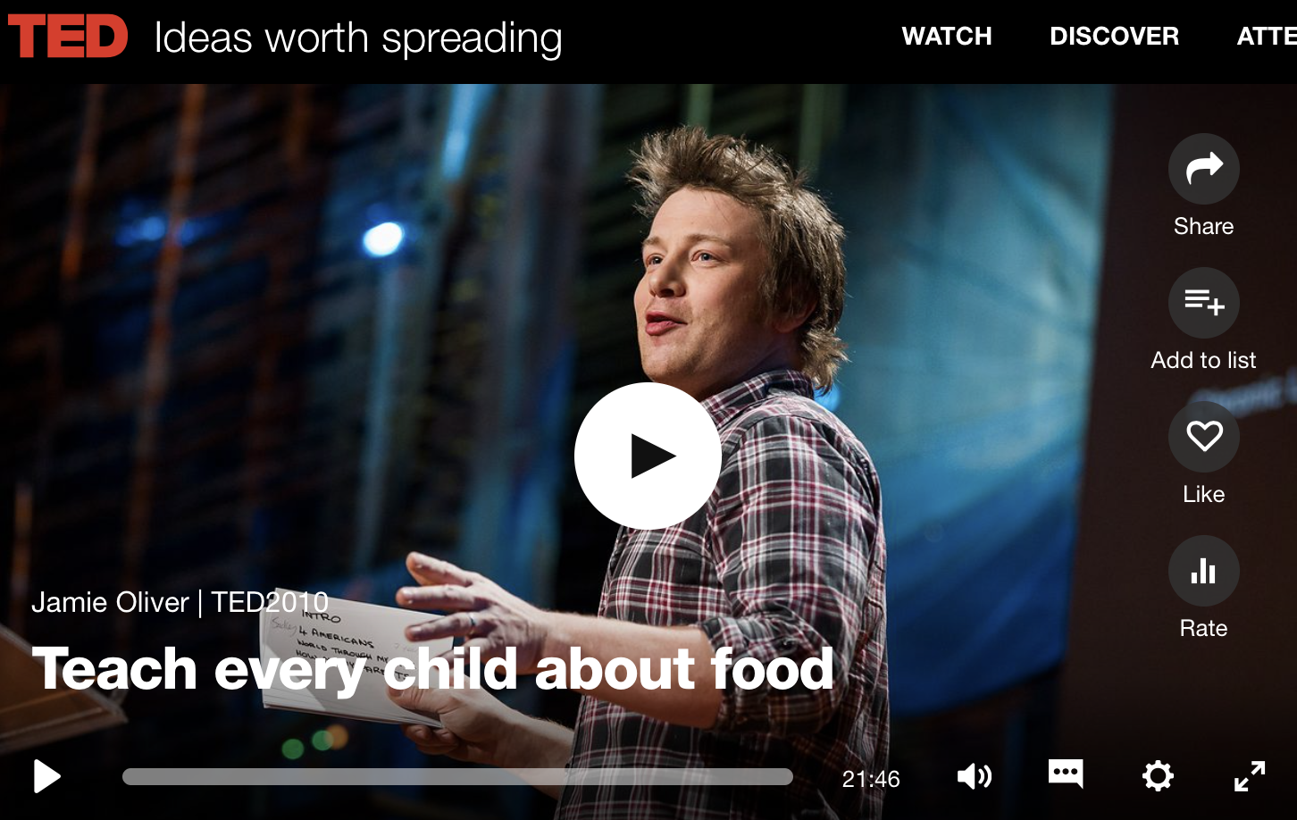
https://www.ted.com/talks/bjorn_lomborg_sets_global_priorities?language=en#t-2777
https://www.ted.com/talks/bill_gates_unplugged?language=en
https://www.ted.com/talks/jamie_oliver?language=en
Notes:
See TEACHING NOTES to Accompany Major Curriculum Activities
https://www.ted.com/talks/bill_gates_unplugged?language=en
https://www.ted.com/talks/bjorn_lomborg_sets_global_priorities?language=en#t-2777
https://www.ted.com/talks/jamie_oliver?language=en

Slide 36
Your friend has a very important class presentation to make next week and you can tell that she is very nervous about it.
What questions will you ask her?
What advice can you give her?
How can you offer to help?
Notes:
See TEACHING NOTES to Accompany Major Curriculum Activities

Slide 37
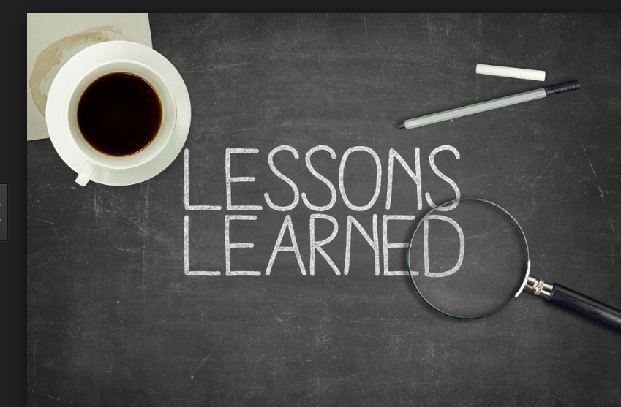
How has your thinking changed?
Will you do anything differently as a result?
Do you plan to make any changes in how you think of yourself?
Do you plan to make any changes in how you relate to others?
What new perspectives can you apply to your studies, work, relationships….?

