Slide 1
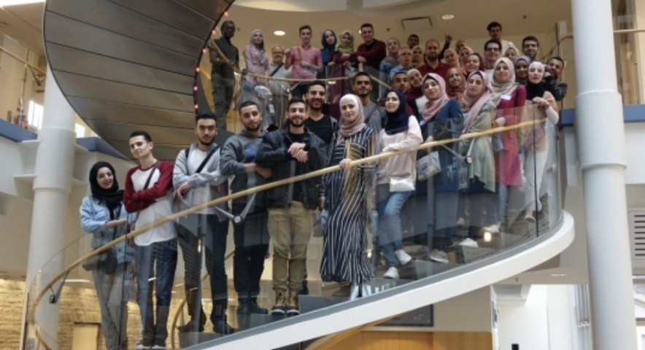
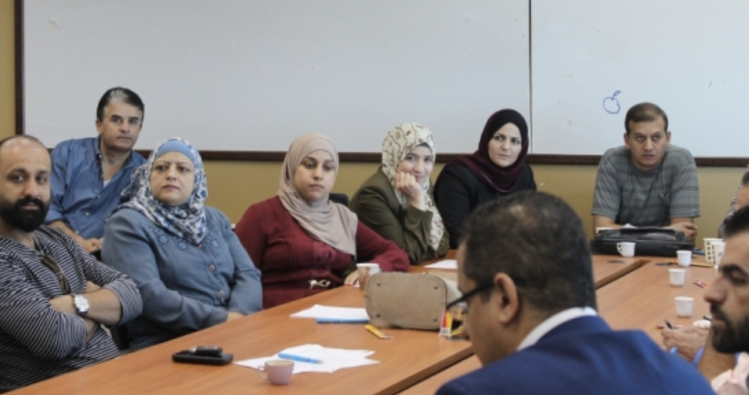
Palestine Polytechnic University
Collaboration: Working in high-performing teams

Slide 2
Groups and teams: What’s the difference?
Stages of team development
Different roles team members play
Being an effective member of a team
Committing to your team and team’s performance

Slide 4
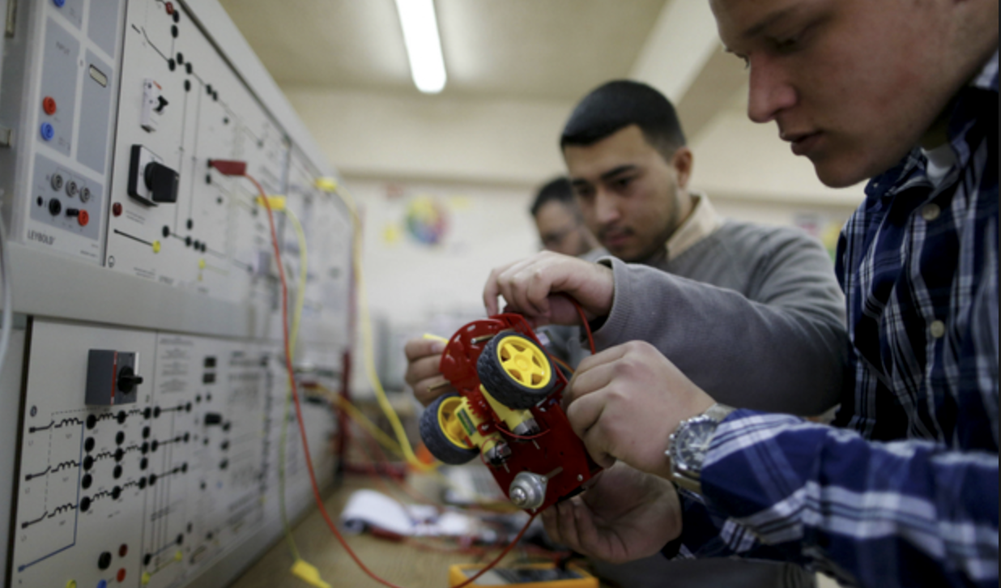
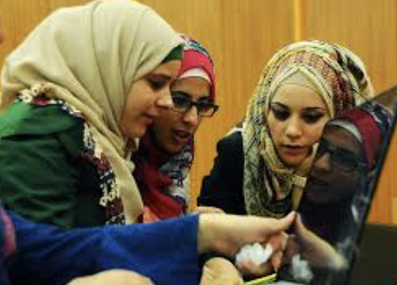
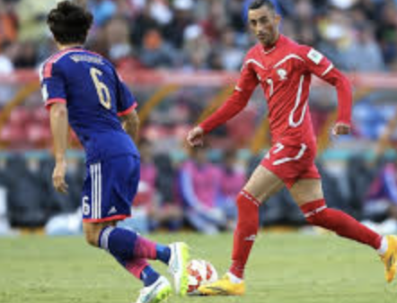
Consider a team you were a member of…
WHAT made that team so great…or not so great?
Be specific - behaviors, personalities, ‘climate’, situational context
How did you personally help, or hinder the team’s performance?
Notes:
See TEACHING NOTES to Accompany Major Curriculum Activities

Slide 5
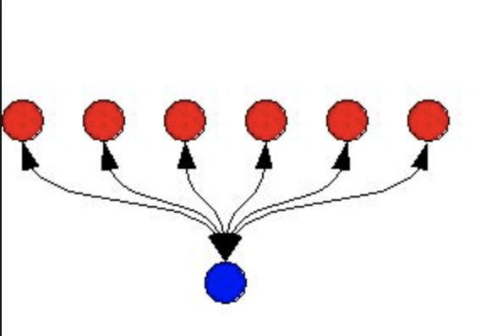
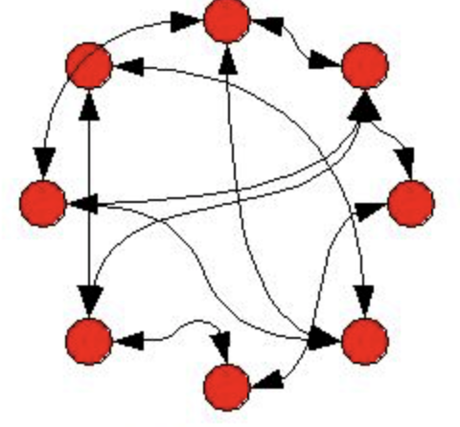
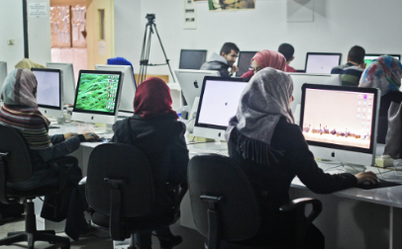
Group vs. Team
Individuals associated together in some activity
Members responsible for their own contributions
Individual approach – no synergy
Individuals assembled together having some unifying relationship
Member’s collective performance determines results
Synergy results

Slide 8
Stages of Team Development
Getting to know members
Determining team’s purpose
Team’s goals questioned
Different work styles emerge
Possible conflict
Establishing formal or informal leaders
Defining expectations of team members
Performing required tasks
Working toward accomplishing goals
For temporary teams, upon completion of task
Getting to know members
Determining team’s purpose

Slide 9
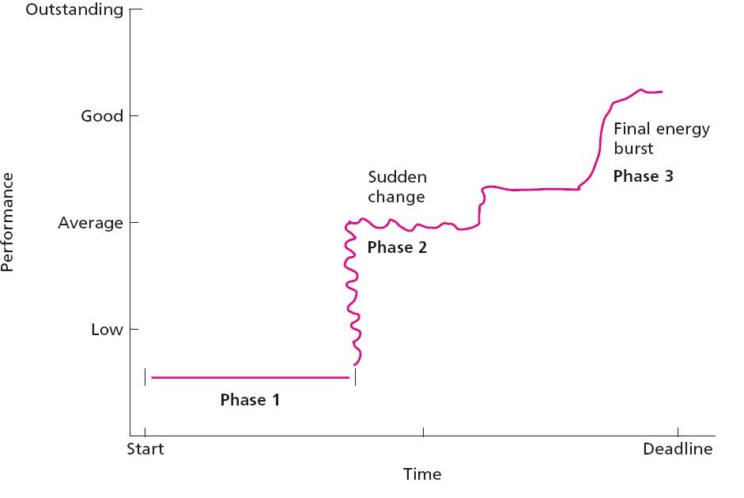
What really happens??
Notes:
Punctuated Equilibrium Model

Slide 10
Everyone Must Agree About
What you’ll accomplish
Why you’re doing it
How you’ll do it
Who will do what
Michael D. Watkins, “Leading the Team You Inherit” Harvard Business Review, June 2016

Slide 11
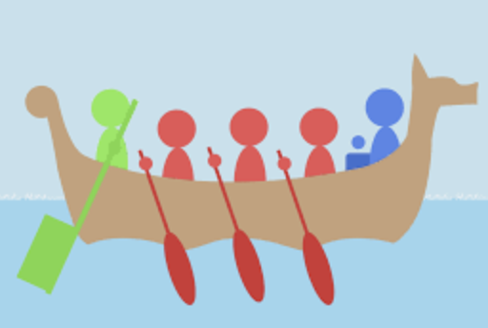
Roles
Expectations regarding appropriate behavior attributed to someone occupying a particular position
Role Perception: Your own expectations about how you are supposed to act in a given situation
Role Expectations: How other people believe a person should act in a given situation
Task-oriented: Team members who contribute the most to the team in order to accomplish the goals
Socio-emotional: Team members who provide moral support, and try to build good working relationships within the team
Self-oriented: Team members who focus on their own personal good and well being, sometimes at the expense of others

Slide 12
Norms
Shared team expectations about appropriate behavior
Prescriptive Norms: Tell team members what acceptable behaviors are
Proscriptive Norms: Tell team members what unacceptable behaviors are

Slide 13
Positive-Negative Norms
Positive
Negative
Standing up for the university/students when unfairly criticized
Always trying to improve
Listening to others
Actively seeking ideas and opinions of others
Caring about the students in your classes
Doing what you say you will do
Being responsible
Saying negative things about your university/fellow students
Taking advantage of others
Accepting sub-standard goals/grades
Putting yourself first
Getting ahead, regardless of costs
Hiding problems from others

Slide 14
Tendency for a person in a team to do less than he or she normally would if they were doing project on their own.

Slide 16
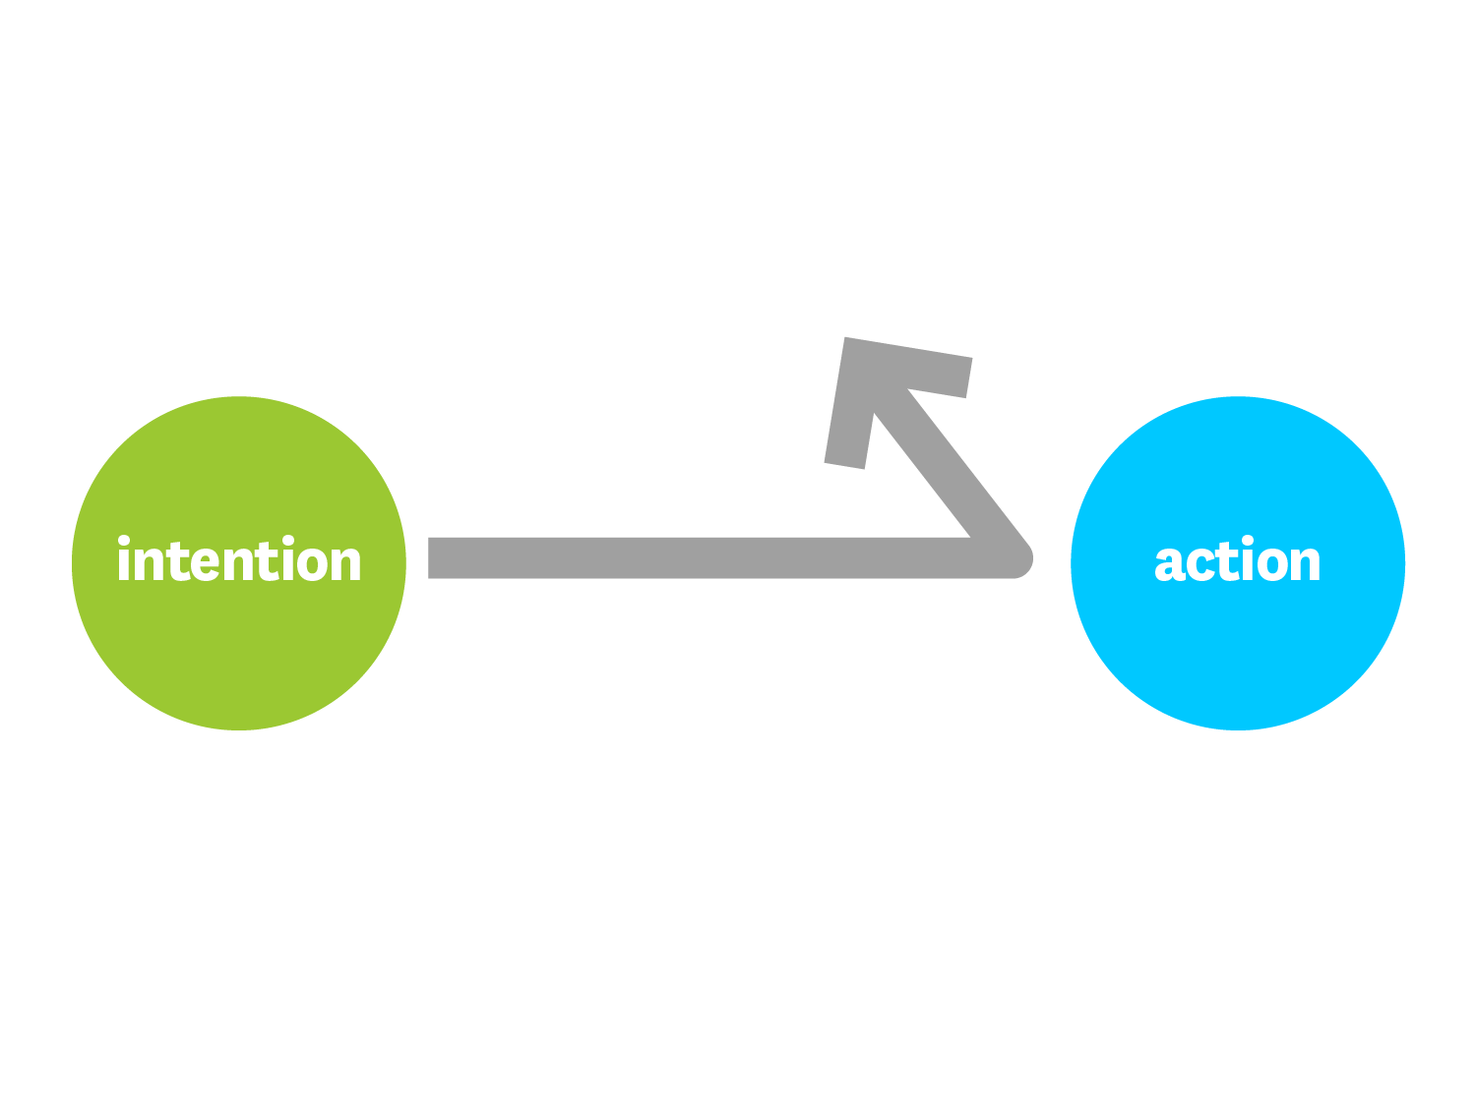

Slide 17
What Stands in Our Way?
Too much to do
Lack of confidence
Competing priorities

Slide 18
On Teams, the Problem Only Gets Worse

Slide 19
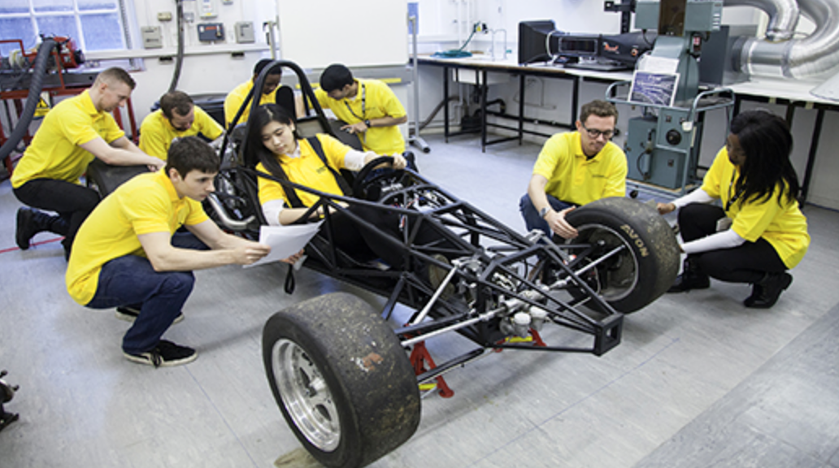
How to build a successful team

Slide 20
Make a plan
Determine priorities
Clear & measurable goals
Create a clear map

Slide 21
Have a shared scorecard
Tracks progress
Reminder of team’s priorities

Slide 22
Develop “rules of the road”
What behaviors will NOT be allowed?
Create a team culture… and stick to it
What behaviors will be encouraged?

Slide 23
Show respect
Respect results in feeling safe
Model behaviors of respect
Zero tolerance for disrespectful behavior

Slide 24
Effective Team Member Behaviors
Listens and responds constructively to other team members' ideas
Offers support for others' ideas and proposals
Is open with other team members about his/her concerns
Expresses disagreement constructively
Reinforces team members for their contributions
Gives honest and constructive feedback to other team members
Provides assistance to others when they need it
Works for solutions that all team members can support
Shares his/her expertise with others
Seeks opportunities to work on teams as a means to develop experience, and knowledge
Provides assistance, information, or other support to others, to build or maintain relationships with them

Slide 25
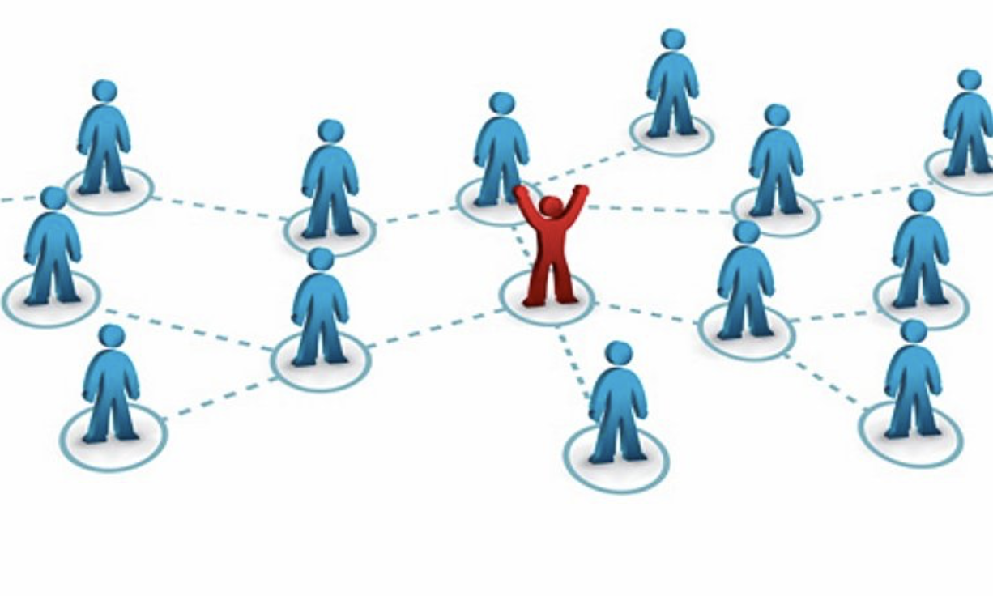
Notes:
See TEACHING NOTES to Accompany Major Curriculum Activities

Slide 26
Trust one another
Engage in functional conflict
Cohesive team members
Commit to decisions & action plans
Focus on achieving collective results
Hold each other accountable
Source: The Five Dysfunctions of a Team, P. Lencioni, Jossey-Bass,

Slide 28
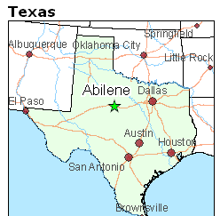
Abilene Paradox: The Management of Agreement
Notes:
See TEACHING NOTES to Accompany Major Curriculum Activities

Slide 29
Team Conflict - Good and Bad
Functional
Task oriented
Focused on differences in perspectives / judgments
Perception of shared commitment to common goals
Has the potential to enhance understanding of (and thereby commitment to) team decision
Dysfunctional
Emotional
Focused on personal incompatibilities or disputes
Perception of personal criticism
Has the potential to lead to cynicism, avoidance or even counter-effort

Slide 30
Your IT Professor has assigned a team project requiring you to develop an APP that helps blind individuals navigate more safely. The project will require substantial collaboration with several students whom you do not really know, and have never worked with before. Your Professor is giving you about 30 minutes at the end of class today to meet with your team and start planning.
Working individually make a list of topics you think you should discuss with your team
In small groups
Consolidate your lists and decide what issues need resolution right away
Develop a preliminary plan to move forward on the class project
Part I
Notes:
See TEACHING NOTES to Accompany Major Curriculum Activities

Slide 31
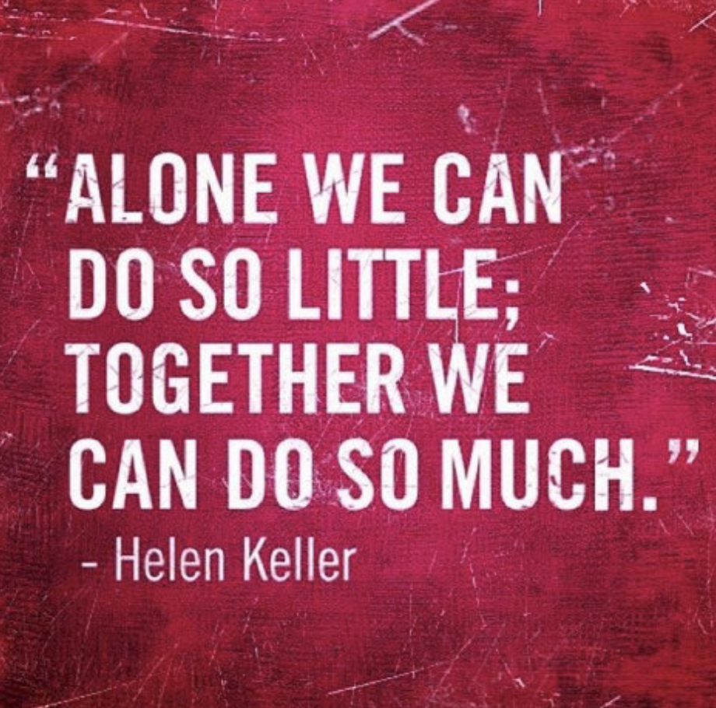
Practical tips for working in student teams

Slide 32
Working styles and priorities
How do you work?
Are you generally someone that procrastinates/works well under pressure?
Are you someone that plans ahead and likes to get things done in advance?
What agreements will you make about working with your different preferences?
What’s your goal for this project?
What grade do you hope to achieve?
What does that mean for your teammates?
How will you work that out as a group?
What is the best way to reach you?
Email? Phone? Text?
What are bad times to reach you—when are you not available?

Slide 33
How will you handle meetings?
What is the structure of your meetings?
Do you want to make time to check-in or socialize at the beginning?
Who will lead the meetings?
Do you want to have someone in charge of making notes on action steps (who does what)?
Being late and missing meetings
How are you going to handle late team members?
Who gets contacted if you’re running late?
Will you start on time even if someone is late?
How will you handle absences? Who gets contacted if someone has to miss a meeting?
Schedule Limitations
What are the best times to meet? What are the worst times to meet?
What other obligations do people have that would prevent them from meeting?
Where are the best places to meet?

Slide 34
Team mates strengths & challenges
What are some individual strengths of people in your team?
Is someone a really strong writer?
Does someone have extensive knowledge of PowerPoint?
Who has the strongest quantitative skills?….
What are some individual challenges -- things that people aren’t necessarily good at?
How will you work with these?
Are there skills that one of you wants to develop?
Skills that you think you could help someone else build?
Skills that someone could help you build?

Slide 35
Division of labor
How are you going to divide up the work for the project?
Who is going to put the final project together? How will you make it sound like one voice?
Do you have someone who can proofread your work?
Is there anything else that you need to make this a successful group work experience?
What kinds of challenges or problems do you think might come up? How will you deal with these?

Slide 36
The case of the missing team member
Notes:
See TEACHING NOTES to Accompany Major Curriculum Activities

Slide 37
Celebrate and appreciate!
Plan a way to celebrate the work you did together, at the end of the project.
Appreciate the fact that you worked very hard together.
What are some ways for your group to celebrate? What would people enjoy? What’s practical?
Is there anything else that you need to make this a successful group work experience?

Slide 38
Your Chemistry Professor has assigned a team project that will require substantial collaboration with several students whom you do not really know, and have never worked with before…
Working individually make a list of promises you would make to your team to show your commitment to the team’s success -- What do you promise to do as a “good” team member??
In small groups – based on the practical tips for effective teamwork…
Revise your list and decide what (other) issues need resolution
Add to your preliminary plan to move forward on the class project
Also, share the promises you would make to your team
Part II
Notes:
See TEACHING NOTES to Accompany Major Curriculum Activities

Slide 39
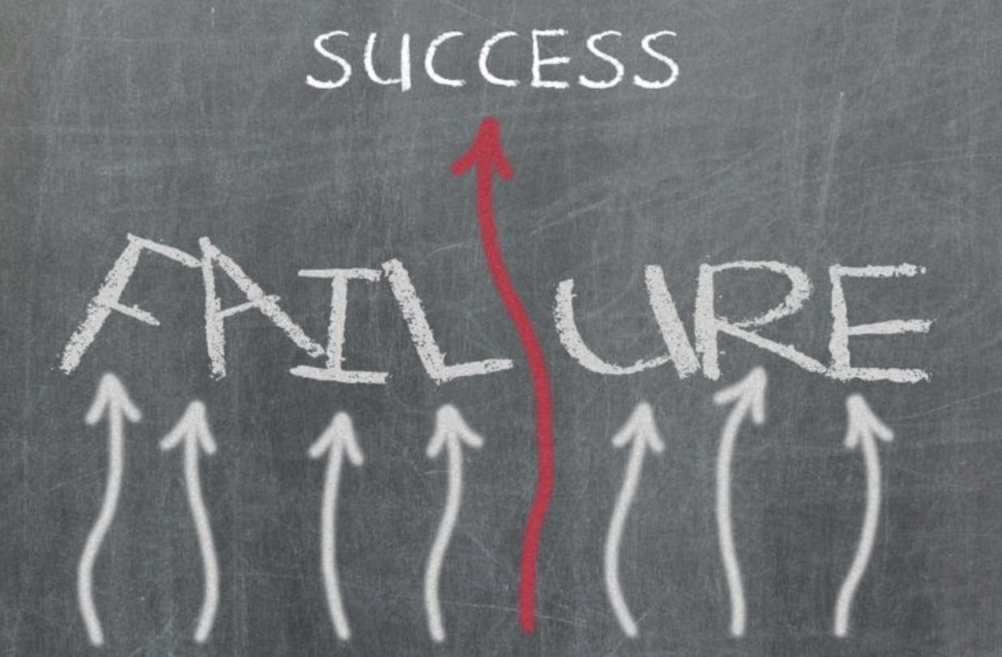
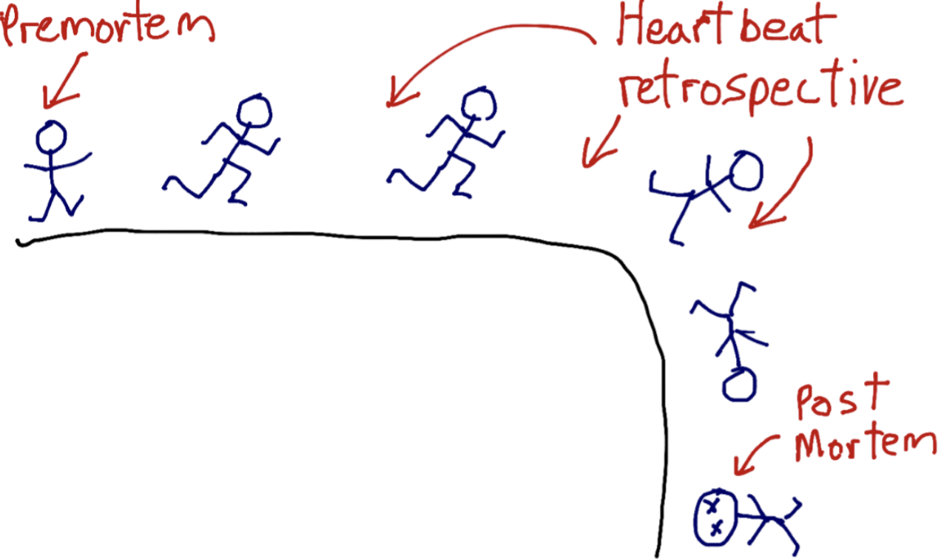
Team imagines that a project has failed, and then works backward to determine what potentially could lead to the failure.

Slide 40
Imagine you have a team project that requires you to give a 20 minute presentation to the class. The project is worth 50% of your entire grade for the course. On the syllabus it is very clear that the professor will not accept late assignments. Your team wants to do everything possible to make sure they get the project completed on time. You decide to do a pre-mortem, pretending that the team submitted the project after the deadline, and as a result, received a failing grade.
Why? How did this happened?
Notes:
Brief Teaching Note:
Some ideas that the students may generate….
One or more students did not do the work that they agreed to and the project was not completed.
One student had the “almost final” project on his/her computer for final editing, and the computer malfunctioned and the file was lost.
It was discovered just before the deadline that one of the student’s plagiarized and the project could not be handed in.
It should be noted that while students are responsible for meeting the deadline, they should go to their teacher before the deadline if they are experiencing serious problems.

Slide 41
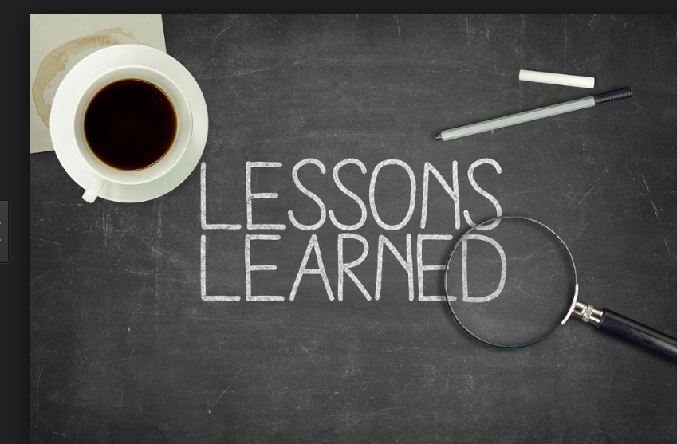
How has your thinking changed?
Will you do anything differently as a result?
Do you plan to make any changes in how you think of yourself?
Do you plan to make any changes in how you relate to others?
What new perspectives can you apply to your studies, work, relationships….?

