Slide 1
Skills for Life! Pursuing your Dreams with Confidence & Determination

Slide 2
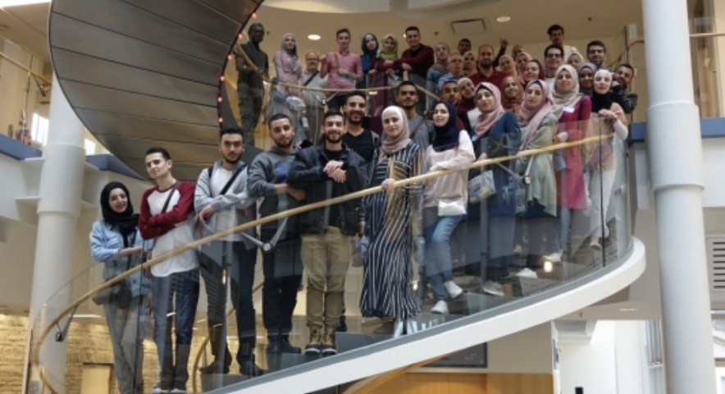
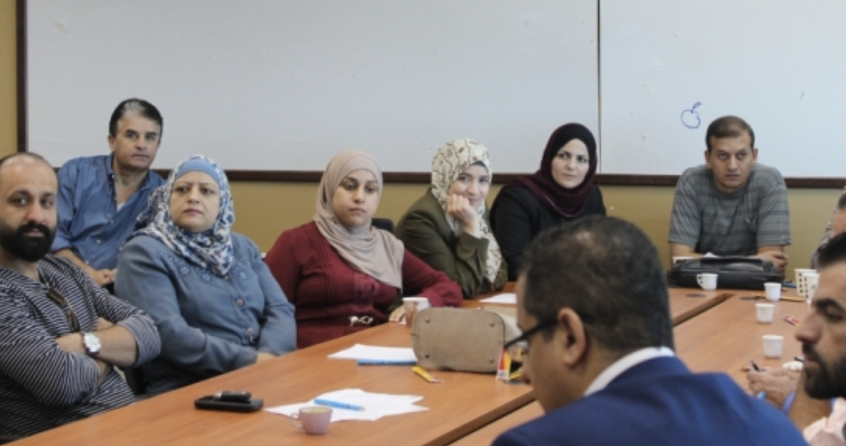
Palestine Polytechnic University
Transition from High School to the University

Slide 3
Difference between high school and college
Understanding the new learning environment
Student as integral part of the learning process
Roles/responsibilities as a university student
Student as a source of knowledge and skill acquisition
Students loyalty and commitment to the university

Slide 4
In teams of 4…
Your task is to meet and get to know 3 new classmates
Introduce yourselves to each other as you would getting to know new friends
Your team of 4 will then stand up and introduce each other to the rest of the class
Decide in your team of 4 who is introducing who (2 x 2)
2 minutes per introduction
The class will then ask questions to get to know each student better
Notes:
See TEACHING NOTES to Accompany Major Curriculum Activities

Slide 5
With other students
With your teachers
With staff members
With mentors
With the community

Slide 6
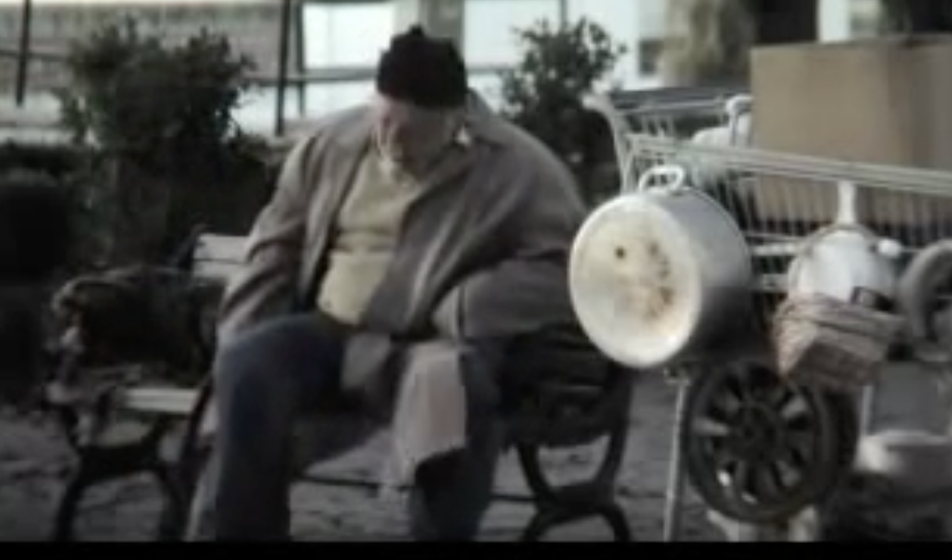
Milk Bum
Notes:
https://www.youtube.com/watch?v=uJEctnzOOxE

Slide 8
Working individually… Think about and make a list of:
all the ways that you think the university will be different than high school
What attitudes and behaviors are associated with successful university students?
In small teams… Consolidate your ideas and discuss:
how high school and university will be different
The attitudes and behaviors that are associated with successful university students
How you may specifically have to change your school-related attitudes and behaviors to be successful
https://www.slideshare.net/usqedu/high-school-vs-uni
Notes:
See TEACHING NOTES to Accompany Major Curriculum Activities

Slide 9
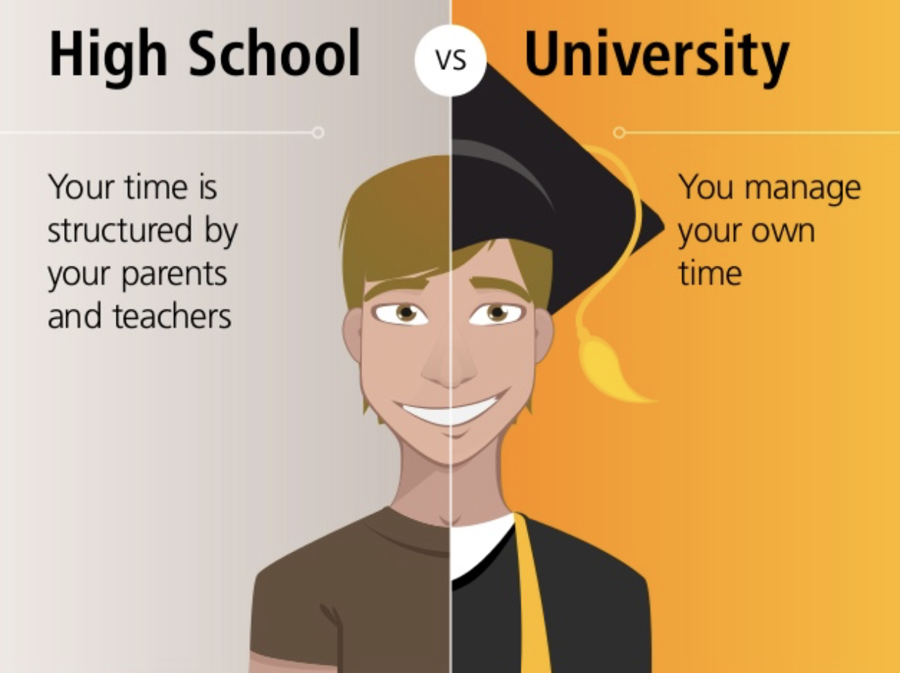

Slide 10
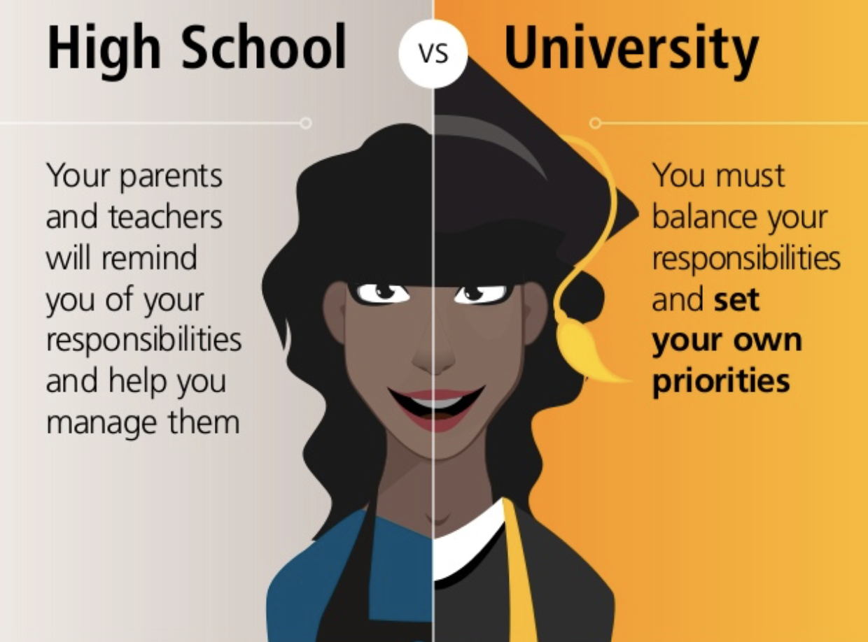

Slide 11
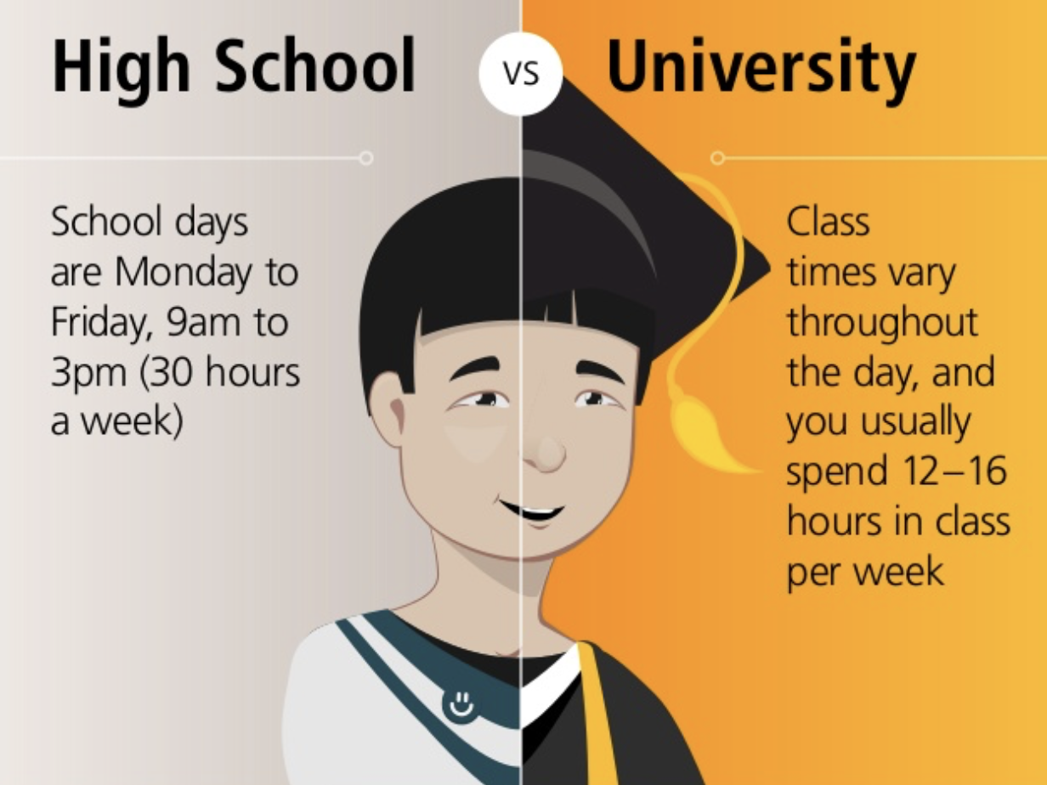

Slide 12
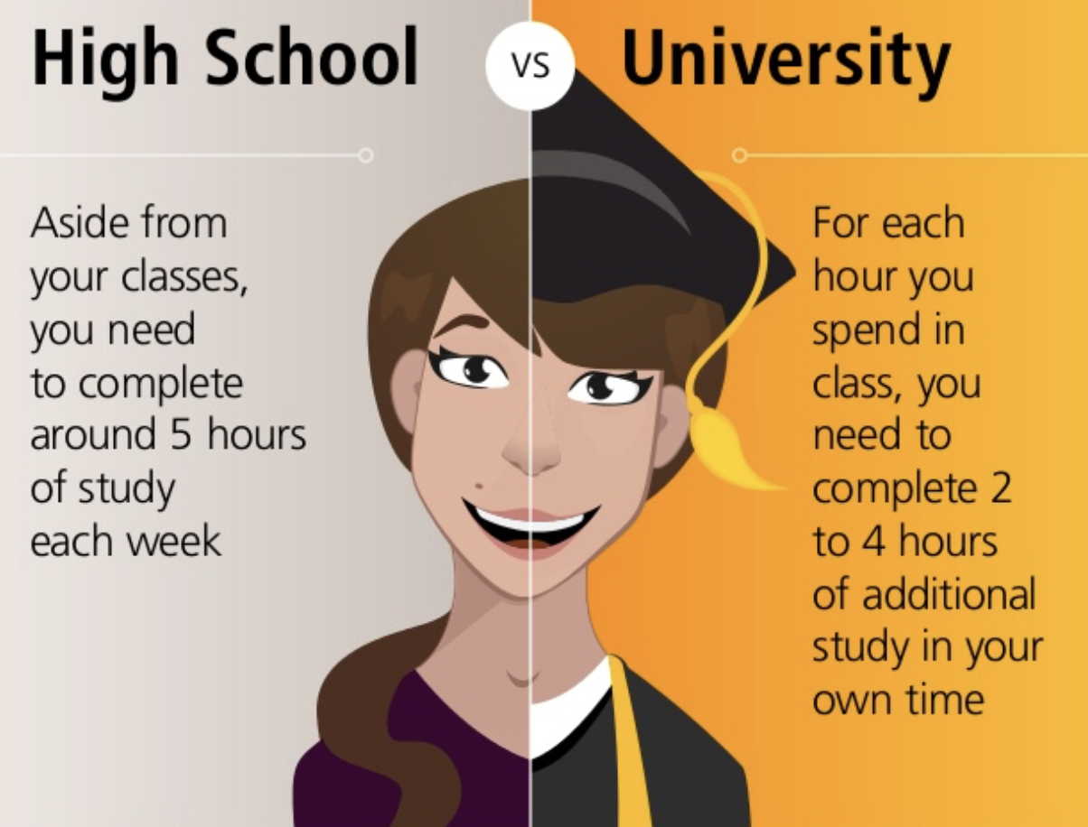

Slide 13
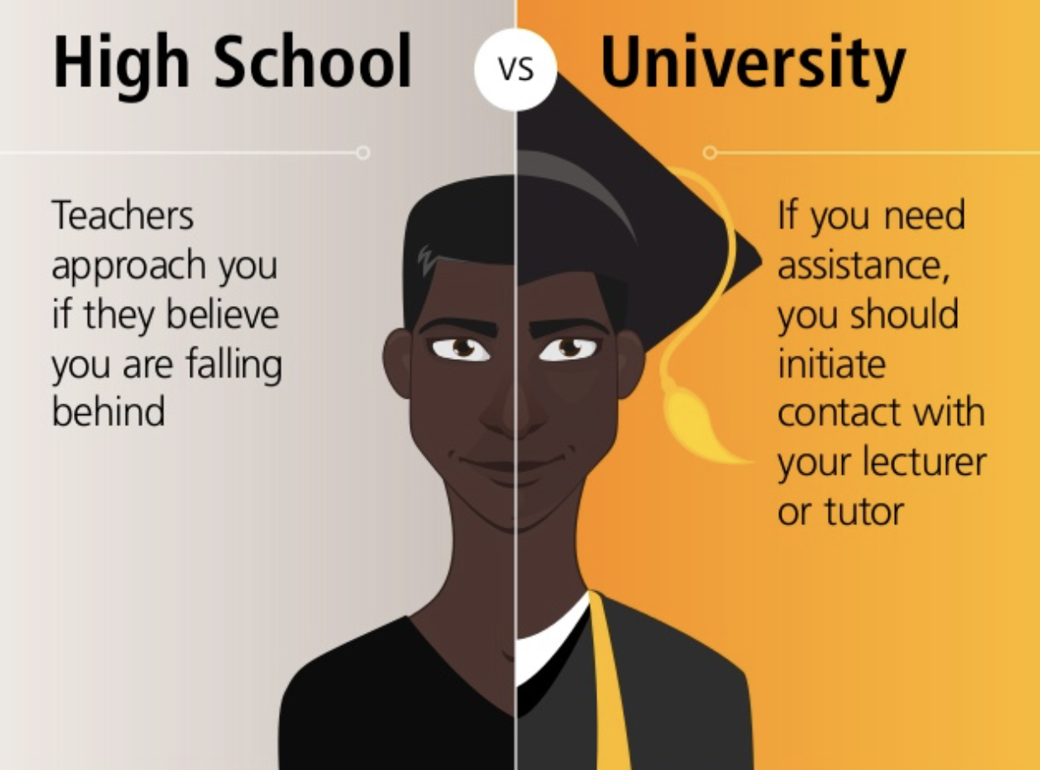

Slide 14
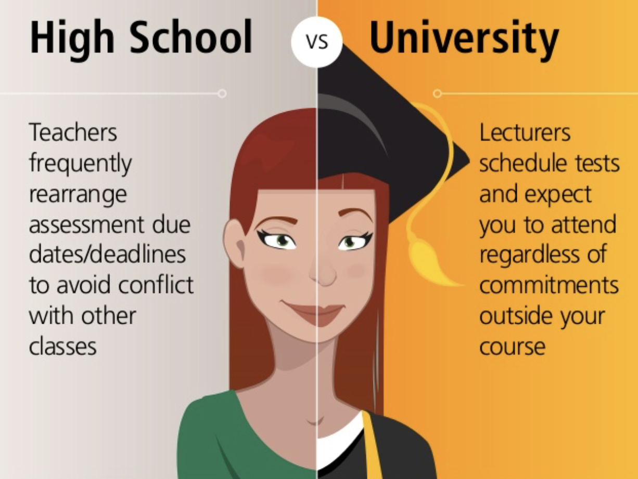

Slide 15
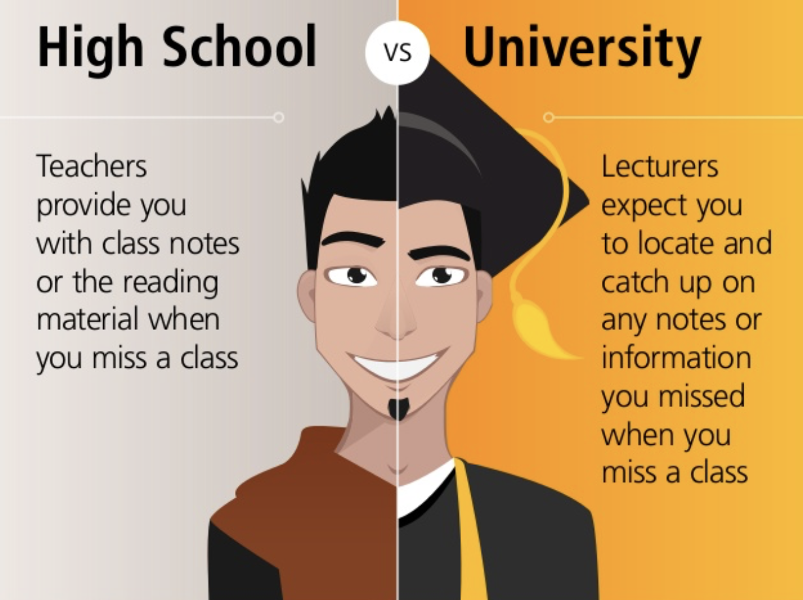

Slide 16
If university studies were easy, everyone would do it
You have full control and responsibility for your learning
Your professors have the responsibility of teaching well and helping you learn, but they cannot do the work for you
Part of college is learning to learn: learning to study, listen better, take notes, do research, be responsible, and most importantly asking for help when you need it

Slide 17
Professors and support staff at PPU do care a great deal about you and will help you when you need it… as long as you are responsible, committed and seriously trying.

Slide 19
You must be committed 100%
Ingredients for success
Do I feel strongly about the need for a university degree?
Am I doing this for myself?
Am I convinced that this can be accomplished?
Do I convey excitement when I talk about going to school?
Am I committed to seeing this through, over the long haul?
Am I willing to make sacrifices to achieve my educational goals?

Slide 20
Qualities of effective university students
Able to manage themselves well
Spending time and following through on things that matter
Strong achievement orientation towards results
Courageous, hardworking and honest
Committed to the university & purposes outside themselves
Committed to building their competencies

Slide 21
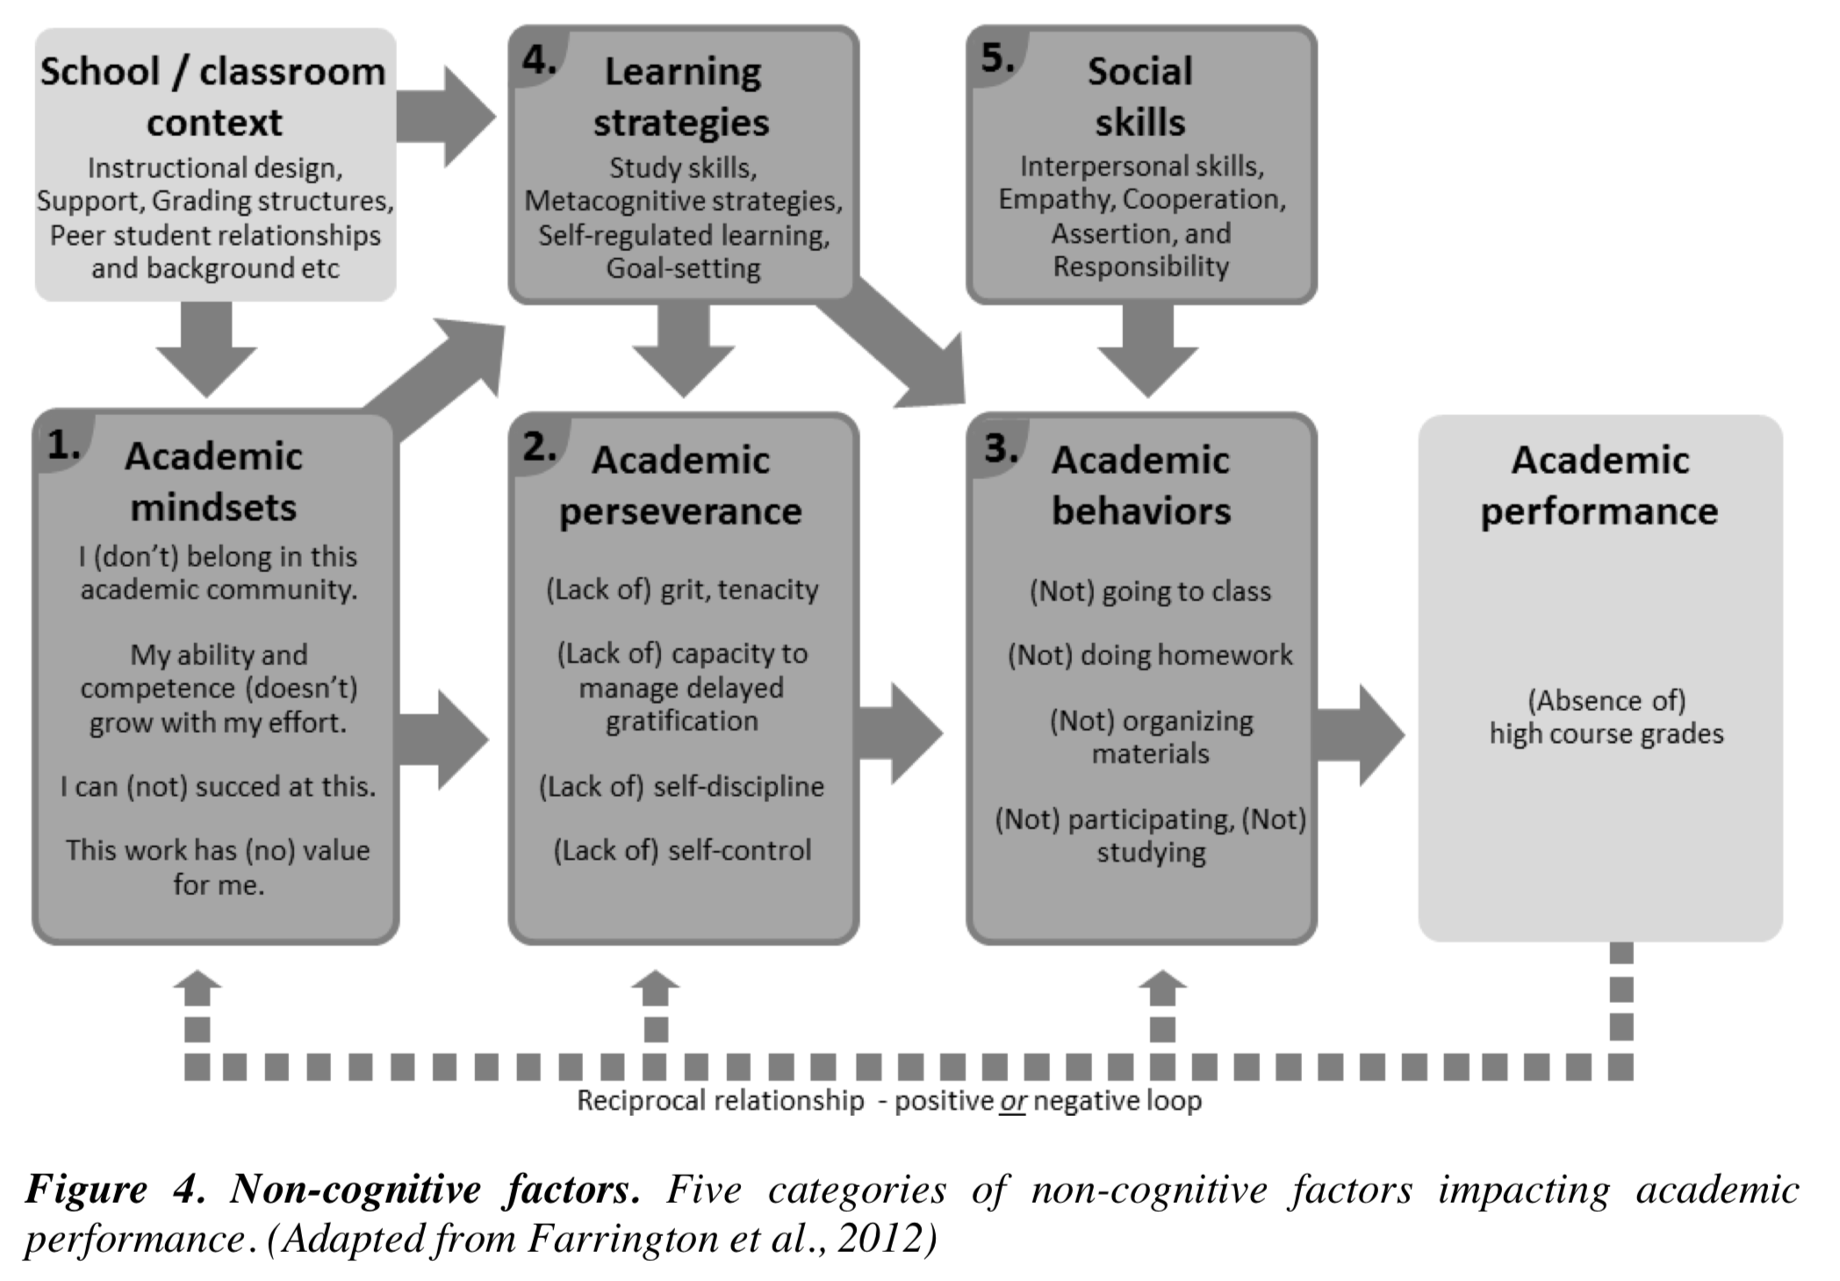
https://www.oecd.org/cfe/leed/BGP_Entrepreneurship-in-Education.pdf
Notes:
https://www.oecd.org/cfe/leed/BGP_Entrepreneurship-in-Education.pdf

Slide 22
Teaching -- Learning
Continuum
TEACHER
STUDENT
Oracle
TEACHING
Passive
LEARNING
Guide
Active
Notes:
.

Slide 23
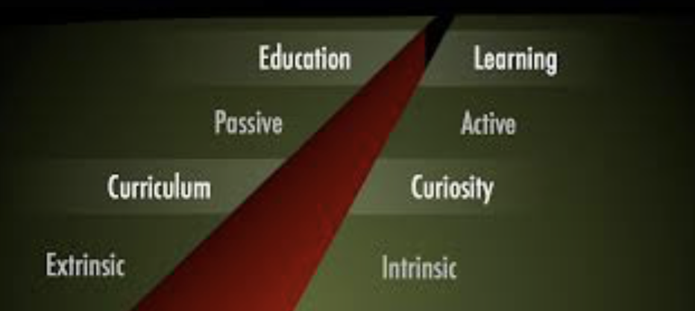

Slide 24
Teaching (education) - centered
Learning (learner) - centered
Knowledge transmitted from teacher to students
Teachers cover topics
Learning based on delivery of information
Students passively receive information
Students learn by listening and reading
Emphasis on right answers
Desired learning is assessed through objective tests
Course delivery often based on:
Lectures
Assignments
Exams
Students actively involved in their own learning
Students build knowledge by gathering information and integrating new learning into what they already know
Students search for knowledge to solve problems
Learning based on engagement of students
Students help other students learn
Learning from errors is part of the process
Desired learning is assessed through papers, projects, cases analyses
Course delivery often based on:
Active learning
Collaborative learning
Problem-based learning
Source: Learner-Centered Assessment on College Campuses, Huba & Freed 2000

Slide 25
Self-Directed Student Learning
Experiment with new behaviors, thoughts, feelings
Commit to learning not just getting good grades
Be honest with yourself about your strengths & weaknesses
Practice new behaviors
Develop trusting relationships- teachers/coaches/ mentors-for help, support, encouragement
What am I really good at?
Be on the lookout for opportunities to learn new things
Where do I need to improve?
Always solicit feedback from others
Where can I get help to build on strengths & reduce gaps?
Adapted from A Leadership Imperative: Building the Emotionally Intelligent Organization, Boyatsis, Van Oosten

Slide 26
Know Yourself
Know the World
You are your own best teacher
You can learn anything you want
Accept responsibility & blame no one
Sales
Make learning a life-long habit
Be curious
Learn by listening to others
Engage in formal learning
Learn from family, friends, mentors
Learn from experience & adversity
Adapted from: On Becoming a Leader, W. Bennis, 2009
True learning and understanding comes from reflecting on your experiences. Always be thinking about what you have learned, and why you have learned it.

Slide 27
Write a brief essay about why you chose to attend PPU/why you are proud to be a PPU student
Review PPU’s website and talk to other students and identify ways that you can learn and contribute (“give back”) beyond classroom and formal learning. Make a list of these ways
Select 2 activities from your list that interest you, and describe why, and how these activities could contribute to your learning, and to helping others
Notes:
See TEACHING NOTES to Accompany Major Curriculum Activities

Slide 28
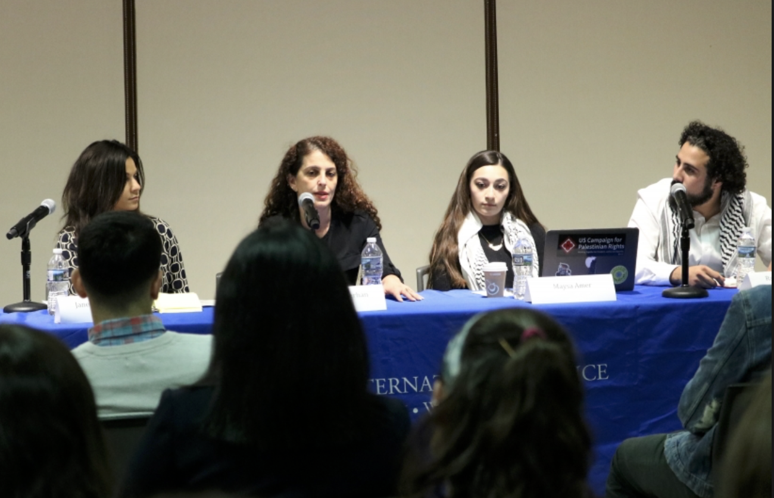
STUDENT PANEL:
Transition from High School to PPU
Notes:
Teaching Note:
Invite a panel of 4-5 second (or third) year PPU students to speak to the class.
Ask each student to prepare individual remarks of about 10 minutes background and about their experience transitioning from HS to PPU, and advice they would give to students.
Some ideas to ask panelists to focus on: Differences in HS and university, expectations for students being responsible for their learning, relationships with teachers and other students, supporting the university via socially responsible activities
Follow by question and answer session.
Total Time: 50 minutes
Debrief:
After the panel leaves, discuss with the class what they learned from the students on the panel, identify important recommendations made by the experienced students, and how these recommendations might be adopted by the entering students. Encourage students to come up with specific examples of how they can apply the advice received to their own university lives.
Total Time: 50 minutes

Slide 29
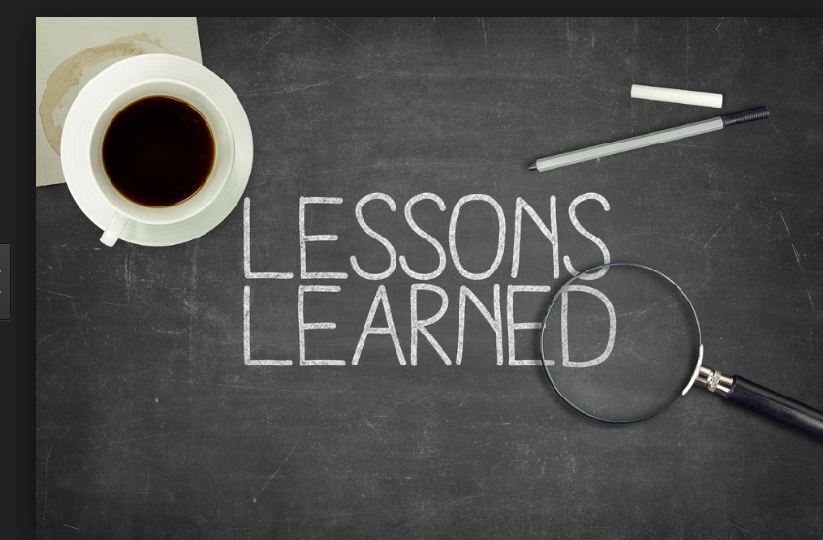
How has your thinking changed?
Will you do anything differently as a result?
Do you plan to make any changes in how you think of yourself?
Do you plan to make any changes in how you relate to others?
What new perspectives can you apply to your studies, work, relationships….?
Notes:
Note to students that all questions may not be relevant

