Slide 1
The Impact of Applying LabVIEW Simulation Platform in Teaching Power Electronic Course for Electrical Engineering Programs
Prof. Sameer Khader
Dept. of Electrical Engineering
Sameer@ppu.edu
1/8/2019

Slide 2
Outline
What is Power Electronics (PE) Course?
The Applications of PE
The Importance of PE for Electrical Engineering Students
Simulation Tools for Teaching PE
What is LabVIEW Simulation Platform
How LabVIEW being Adopted in Teaching PE Course
Examples Using LabVIEW Platform
Students Evaluation & Feedbacks
Summary & Recommendation

Slide 3
What is Power Electronics (PE) Course?
Power electronics combine power, electronics, and control.
Application of solid state electronics for the control and conversion of electric power.
The focus in power electronics is on conversion efficiency of conversion and control of energy.
Power electronics is based primarily on the switching of the power semiconductor devices.

Slide 4
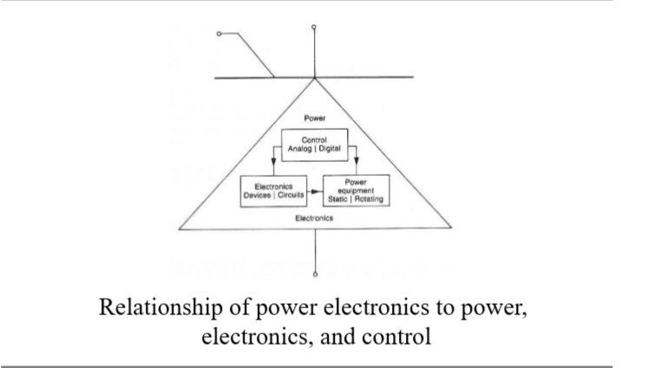
What is Power Electronics (PE) Course?...cont’d
Relationship:

Slide 5
What is Power Electronics (PE) Course?...cont’d
Power Semiconductor Devices:
1.Power Diodes
2. Thyristors
3. Power Bipolar Junction Transistors (BJTs)
4. Power MOSFETs
5. Insulated-Gate Bipolar Transistors (IGBTs)
6. Static Induction transistors(SITs)

Slide 6
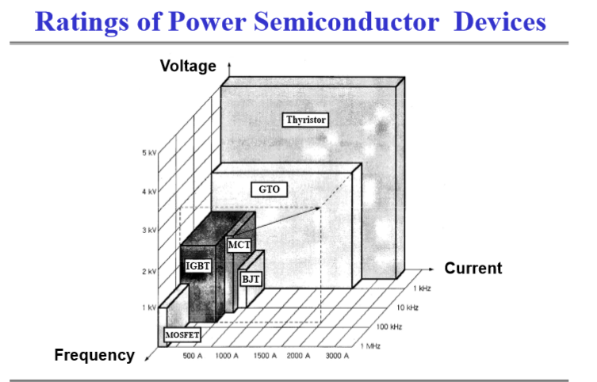
What is Power Electronics (PE) Course?...cont’d

Slide 7
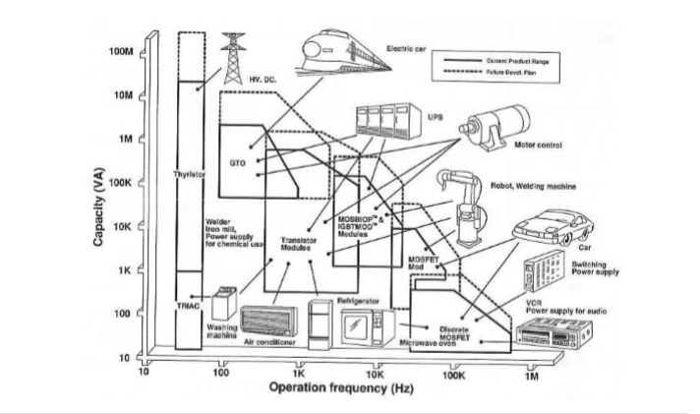
Applications of Power Electronics

Slide 8
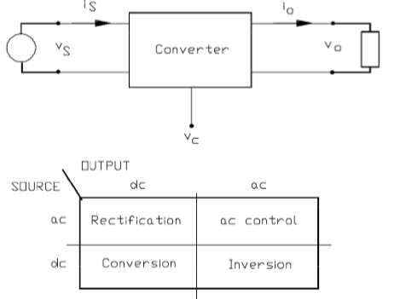
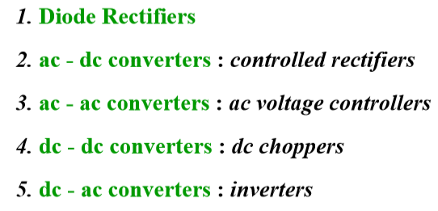
Power Electronics Converters

Slide 9
The Importance of PE for Electrical Engineering Students
Engineering Knowledge
Basic Electronics converters
Building simple practical circuits
Research
Power electronic converters , Harmonic mitigation, power quality, compensators
Renewable energy systems, optimization of power quality, power factor management…
Understanding Various disciplines
Senior Courses
Practical Skills
Graduation Project
Linking several topics and disciplines such electronics, networks, control and sensors
Advanced Drive and Automation courses
Advanced Power transmission and distribution systems & regulations
Building simple and complicated electronic converters
Building complicate drive circuits
Building complete PE systems that combing Electronics, Power & Control such as Elevators, escalators, production lines, stone cutting systems, filling systems…
Because of these arguments , SIMULATION TOOLS are very important in explaining, analyzing and teaching PE course for better understanding and effectiveness…..

Slide 10
Simulation Tools for Teaching PE Course
1
Matlab/ Simulink, - Mathcade, USA
2
PSIM/ POWERSYS, France
3
Pspice, USA
4
5
6
Plecs/ Plexim - Sweden
LabVIEW- National Instruments, USA
MultiSim- USA
7
RetScreen- Canada
8
Volts, Canada
9
etc…

Slide 11
What is LabVIEW Simulation Platform ?
Graphical System Design .
Lab - Laboratory
V- Virtual
I- Instrumentation
E- Engineering
W- Workbench

Slide 12
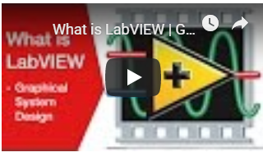
What is LabVIEW Simulation Platform ?.....cont’d
LabVIEW offers a graphical programming approach that helps you visualize every aspect of your application, including hardware configuration, measurement data, and debugging.
This visualization makes it simple to integrate measurement hardware from any vendor, represent complex logic on the diagram, develop data analysis algorithms, and design custom engineering user interfaces.
LabVIEW uses a graphic interface that enables different elements to be joined together to provide the required flow.
Furthermore, LabVIEW isa systems engineering software for applications that require test, measurement, and control with rapid access to hardware and data insights.
And remotely controlling certain process, mission and task….

Slide 13
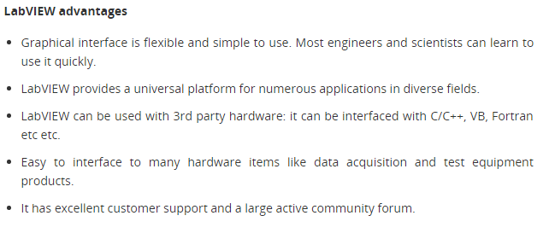
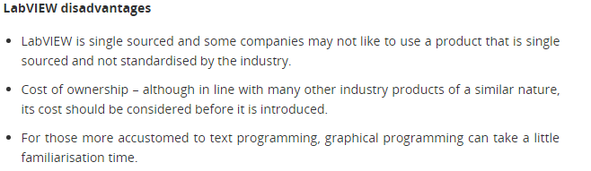
What is LabVIEW Simulation Platform ?.....cont’d
LabVIEW is systems engineering software for applications that require test, measurement, and control with rapid access to hardware and data insights.
LabVIEW offers a graphical programming approach that helps you visualize every aspect of your application, including hardware configuration, measurement data, and debugging.
This visualization makes it simple to integrate measurement hardware from any vendor, represent complex logic on the diagram, develop data analysis algorithms, and design custom engineering user interfaces.
Demonstration Video
https://www.ni.com/en-us/shop/labview.html
LabVIEW is systems engineering software for applications that require test, measurement, and control with rapid access to hardware and data insights.

Slide 14
How LabVIEW being Adopted in Teaching PE Course ?
Integrating the built circuit with LabVIEW platform.
Building the LabVIEW interface panel with required control modules and indicators.
Simulating the real time results and conducting the required discussions, calibrations and judgments.
Building the physical electrical circuit using Multisim.

Slide 15
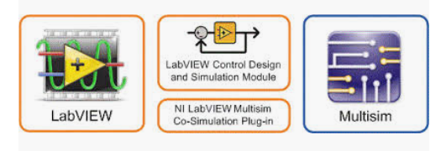
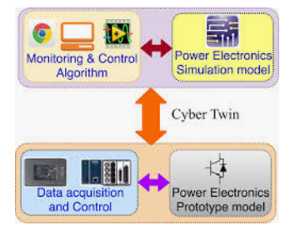
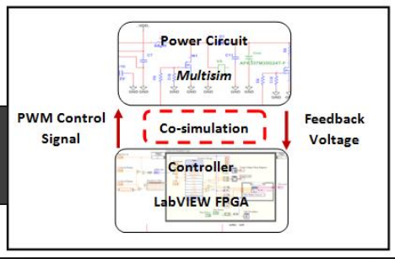
How LabVIEW being Adopted in Teaching PE Course ?...cont’d
SIMULATION PROCEDURE:
LabVIEW is systems engineering software for applications that require test, measurement, and control with rapid access to hardware and data insights.
LabVIEW offers a graphical programming approach that helps you visualize every aspect of your application, including hardware configuration, measurement data, and debugging.
This visualization makes it simple to integrate measurement hardware from any vendor, represent complex logic on the diagram, develop data analysis algorithms, and design custom engineering user interfaces.
Demonstration Video
https://www.ni.com/en-us/shop/labview.html
LabVIEW is systems engineering software for applications that require test, measurement, and control with rapid access to hardware and data insights.

Slide 16
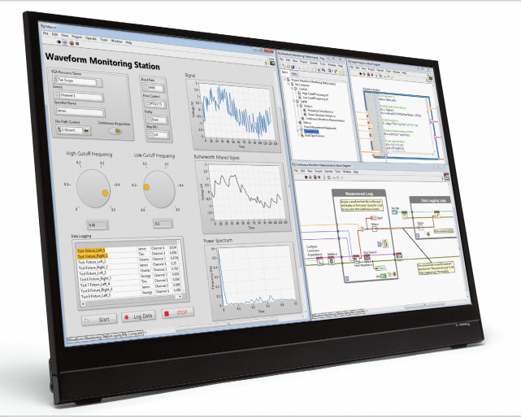
How LabVIEW being Adopted in Teaching PE Course ?...cont’d
Complete Control Module with Multi screens
LabVIEW is systems engineering software for applications that require test, measurement, and control with rapid access to hardware and data insights.
LabVIEW offers a graphical programming approach that helps you visualize every aspect of your application, including hardware configuration, measurement data, and debugging.
This visualization makes it simple to integrate measurement hardware from any vendor, represent complex logic on the diagram, develop data analysis algorithms, and design custom engineering user interfaces.
Demonstration Video
https://www.ni.com/en-us/shop/labview.html
LabVIEW is systems engineering software for applications that require test, measurement, and control with rapid access to hardware and data insights.

Slide 17
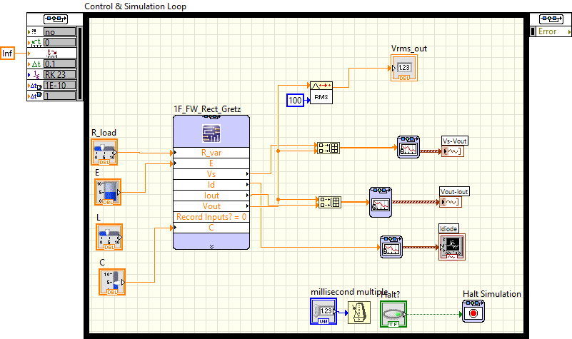
Examples Using LabVIEW Platform
Monitoring
1- Simple PE Circuit ( Rectifier- Bridge Circuit)
Input/output communications
Interaction
Multisim Circuit
LabVIEW Platform

Slide 18
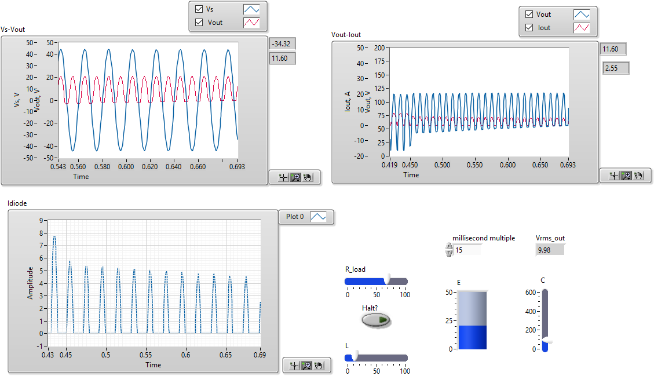
Examples Using LabVIEW Platform -Results ( Rectifier- Bridge Circuit)

Slide 19
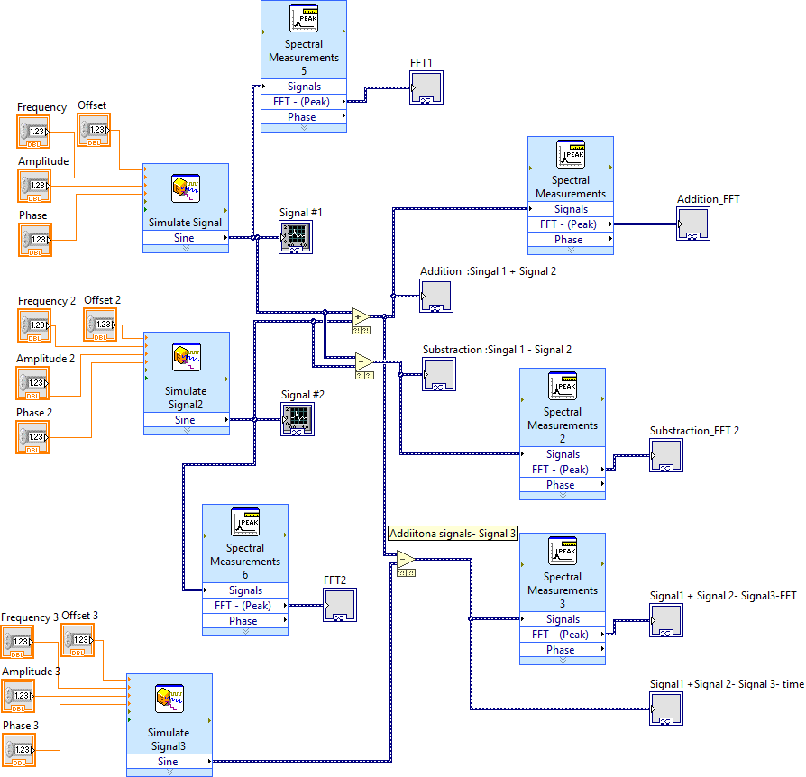
Examples Using LabVIEW Platform- Frequency Analyzer

Slide 20
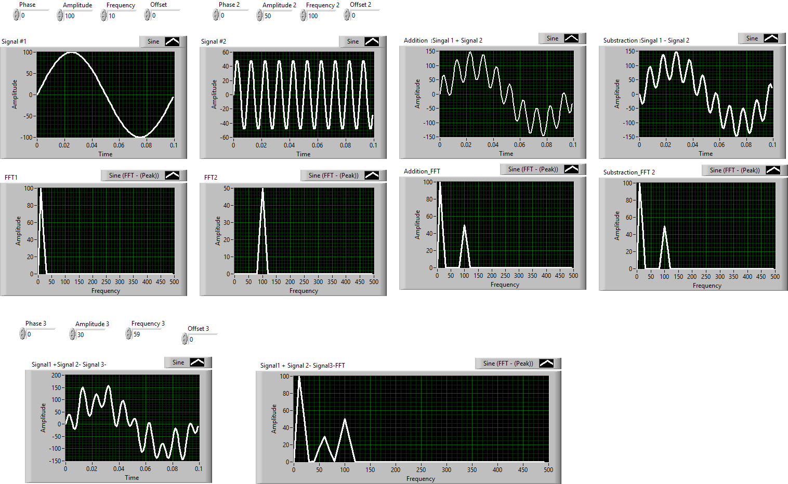
Examples Using LabVIEW Platform -Results ( Frequency Analyzer)

Slide 21
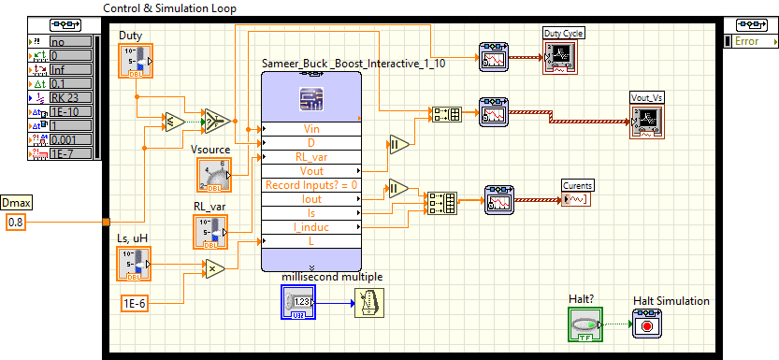
Examples Using LabVIEW Platform- DC to DC Converter- Chopper
Electrical circuit
(Buck-Boost Chopper)
Multisim
LabVIEW

Slide 22
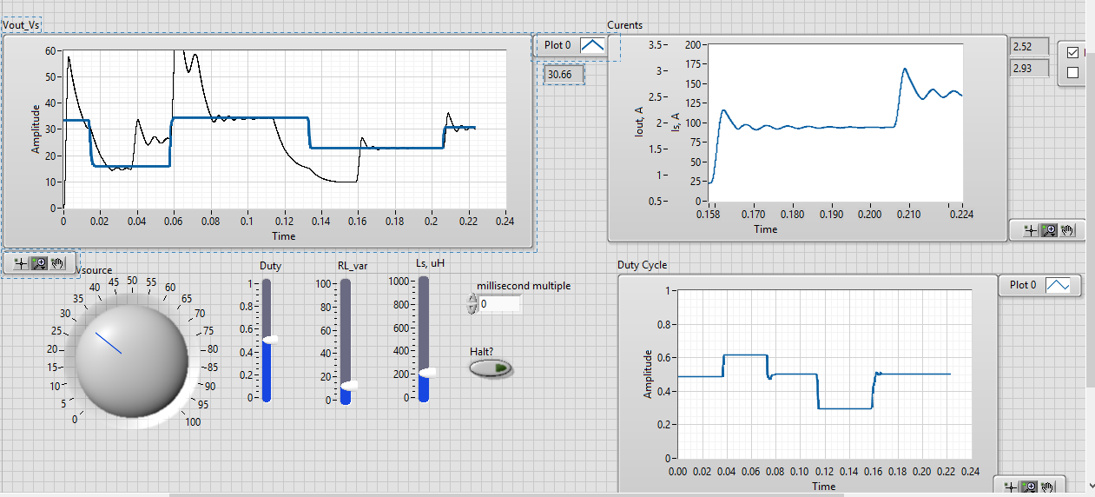
Examples Using LabVIEW Platform -Results ( Dc-DC Converter)

Slide 23
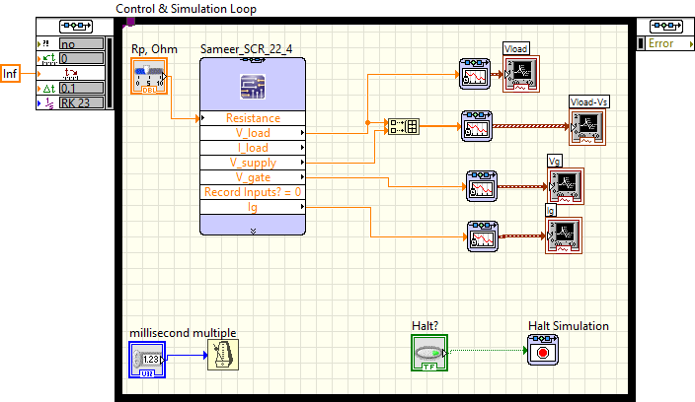
Examples Using LabVIEW Platform- Thyristor Control

Slide 24
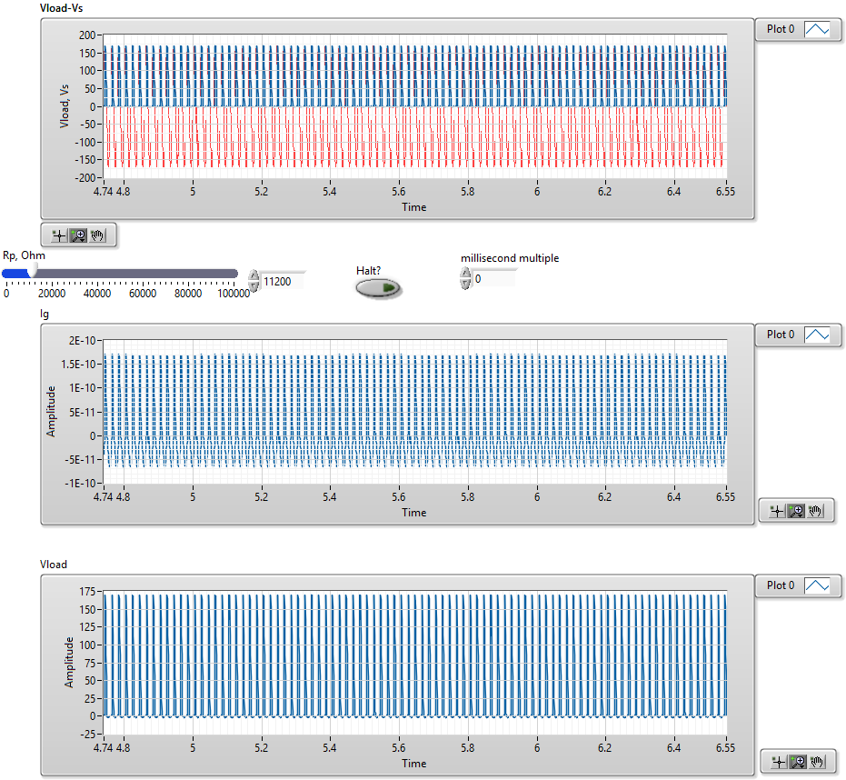
Examples Using LabVIEW Platform -Results ( Thyristor firing)

Slide 25
Examples Using LabVIEW Platform- DC to AC Converter- Inverter-
Multisim Circuit

Slide 26
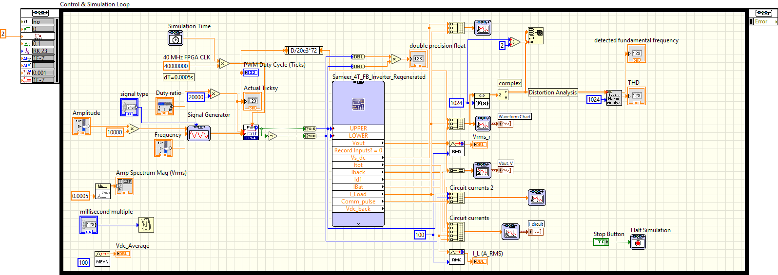
Examples Using LabVIEW Platform- DC to AC Converter- Inverter-
Multisim
LabVIEW Circuit

Slide 27
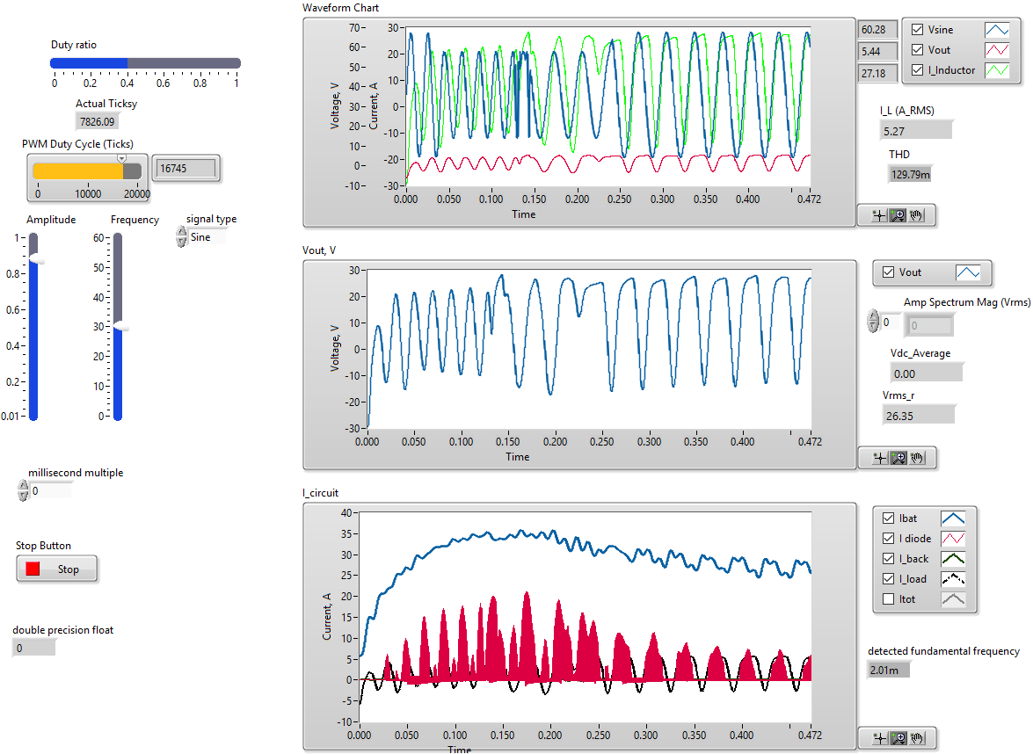
Examples Using LabVIEW Platform -Results ( CD- AC Converter)

Slide 28
Examples Using LabVIEW Platform- CSI Inverter

Slide 29
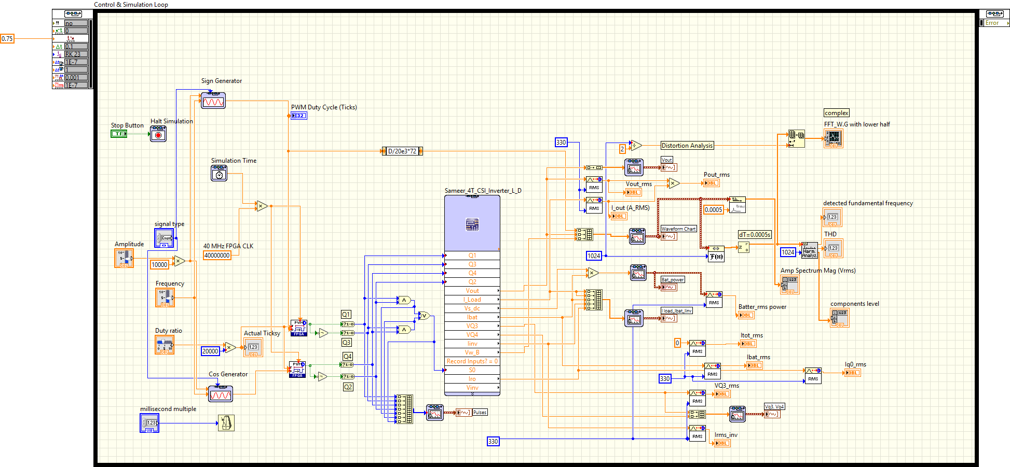
Examples Using LabVIEW Platform- CSI Inverter

Slide 30
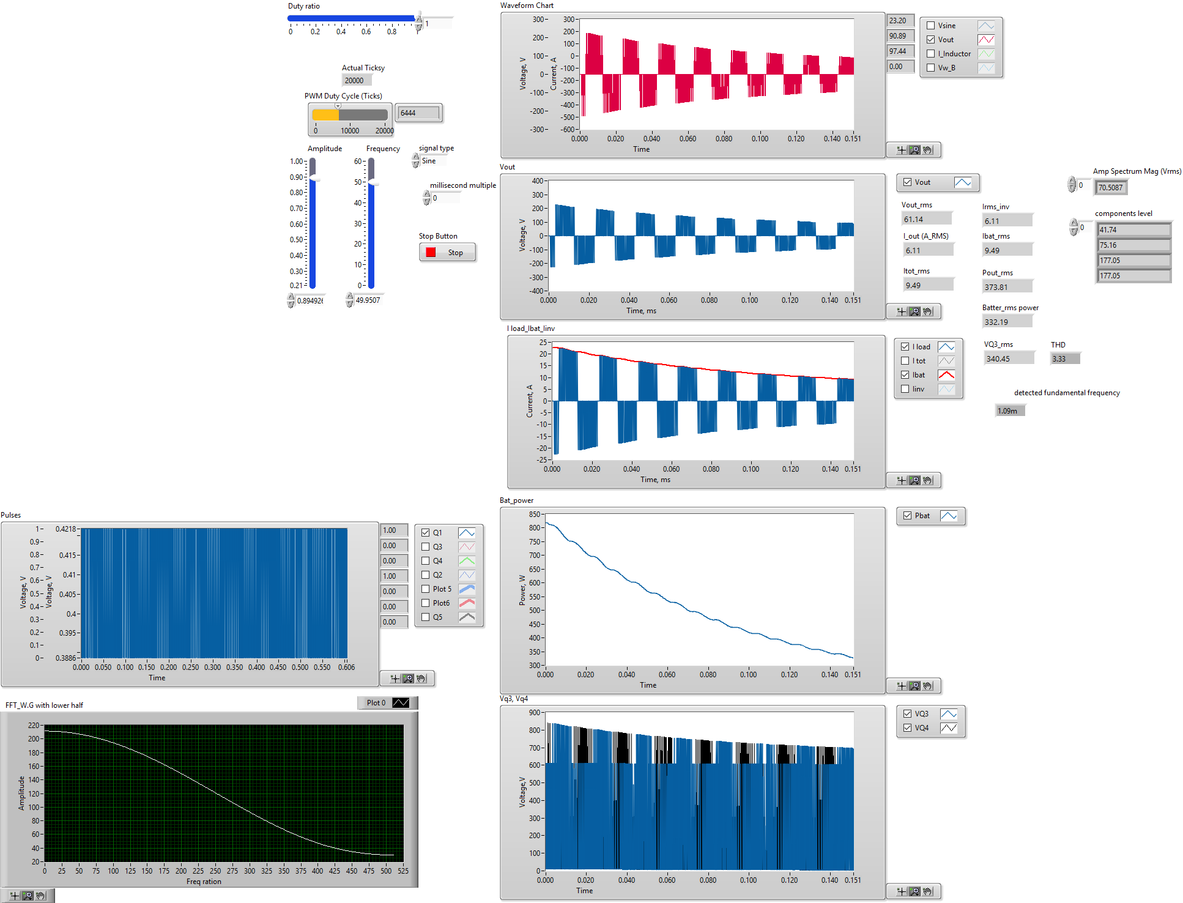
Examples Using LabVIEW Platform -Results ( CSI Inverter)

Slide 31
Student Evaluation & Feedback
Q1- Do you agree with the proposed teaching procedure?
Q2- Have you better understand the topic using LabVIEW simulation?
Q3- Can you build your simulation model after demonstrating certain class examples?
Q4- Have you been able to link theoretical information to simulation results?
Q5- Do you feel that you understand electrical phenomena better by using this method of explanation?
Q6- If you have the opportunity to learn similar subjects , do you prefer this method of explanation in teaching ?

Slide 32
Student Evaluation & Feedback- Survey data
32 Students-PPU
33 Students AQU
65 students were surveyed
 |  | Evaluation
No | Questions | Excellent | Very Good | Good | not satisfied
Q1 | Do you agree with the proposed teaching procedure | 36 | 16 | 8 | 5
Q2 | Have you better understand the topic using LabVIEW simulation | 30 | 21 | 10 | 4
Q3 | Can you build your simulation model after demonstrating certain class examples | 33 | 20 | 7 | 5
Q4 | Have you been able to link theoretical information to simulation results | 28 | 28 | 5 | 4
Q5 | Do you feel that you understand electrical phenomena better after using this method of explanation | 27 | 24 | 11 | 3
Q6 | If you have the opportunity, do you prefer this method of explanation | 36 | 20 | 7 | 2

Slide 33
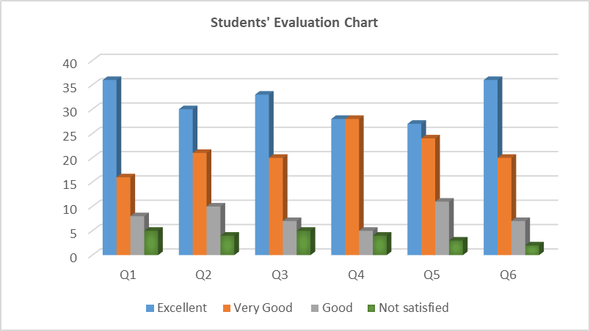
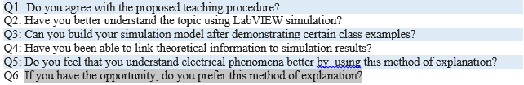
Student Evaluation & Feedback- Results

Slide 34
Summary & Recommendations
From the proposed chart, the following statements can be stated:
75% of students are completely agreed with the proposed teaching method
78% of students are better understood the course topics
86% of students are strongly would attend such courses
As a result :
This course presents unique case that can be proposed for another courses in the university, having in mind that PPU is the first university in Palestine introduces LabVIEW platform in teaching such courses.

Slide 35
Thank you for your listening….

